Slide 1
CRANE Database - Video Demonstration
March 2026
How to find patients awaiting consent verification or those with missing key information (missing cleft type, NHS number, name and postcode)

Slide 2
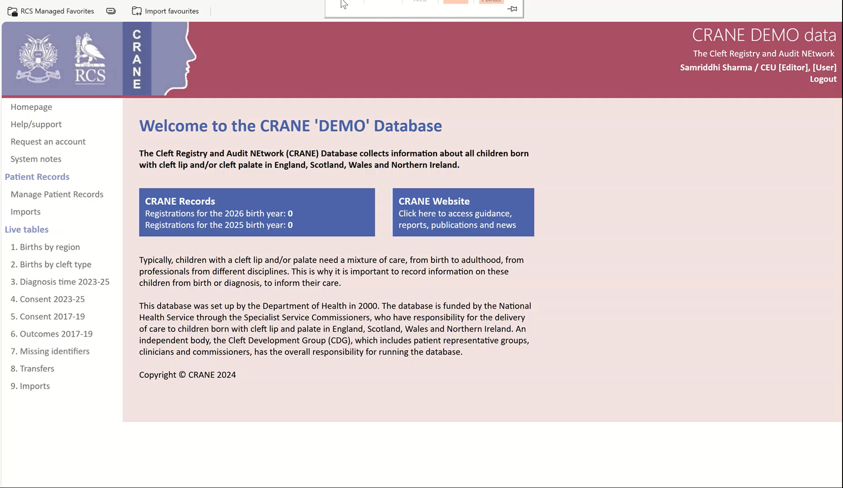

Slide 3
Resources and Guides
Accessing the CRANE Database:
Guide: Quick reference for accessing the CRANE Database - CRANE Database
Managing patient records:
Guide: Quick reference for managing patient records - CRANE Database
Guide for exporting data from CRANE Database:
Guide: Quick reference for Exporting - CRANE Database

Slide 4
Thank you
If you need further support please get in touch
  Email – crane@rcseng.ac.uk
  Tel – 020 7869 6135

