Slide 1
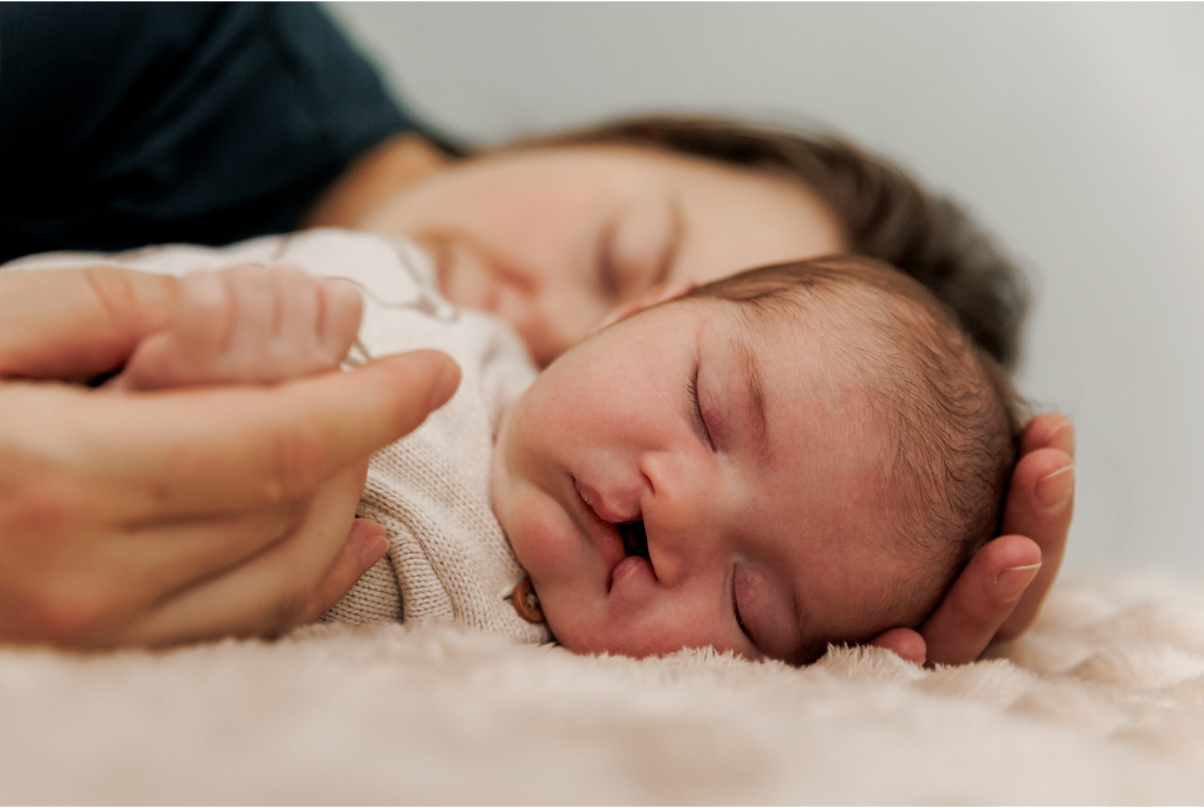
Making it better
22 January 2026
Craig Russell & Kate Fitzsimons
On behalf of the CRANE Database team

Slide 2
Overview
Welcome and introductions
2025 Annual Report
Overview of data completeness and outcomes by report year & year of birth
New features of the report, including risk adjustment & outlier process
Good practice recommendations from outlier responses
Organisational Audit summary
Shared learning relating to good practice and challenges (8 speakers)
Q&A session
CRANE Database developments

Slide 3
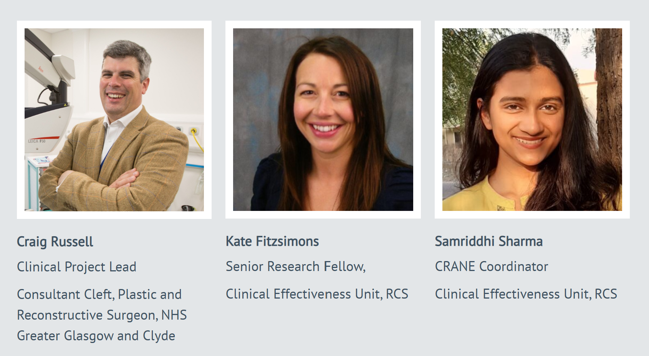
Welcome & introductions
Abhishek Dixit
Data Manager/Data Scientist, Clinical Effectiveness Unit, RCS

Slide 4
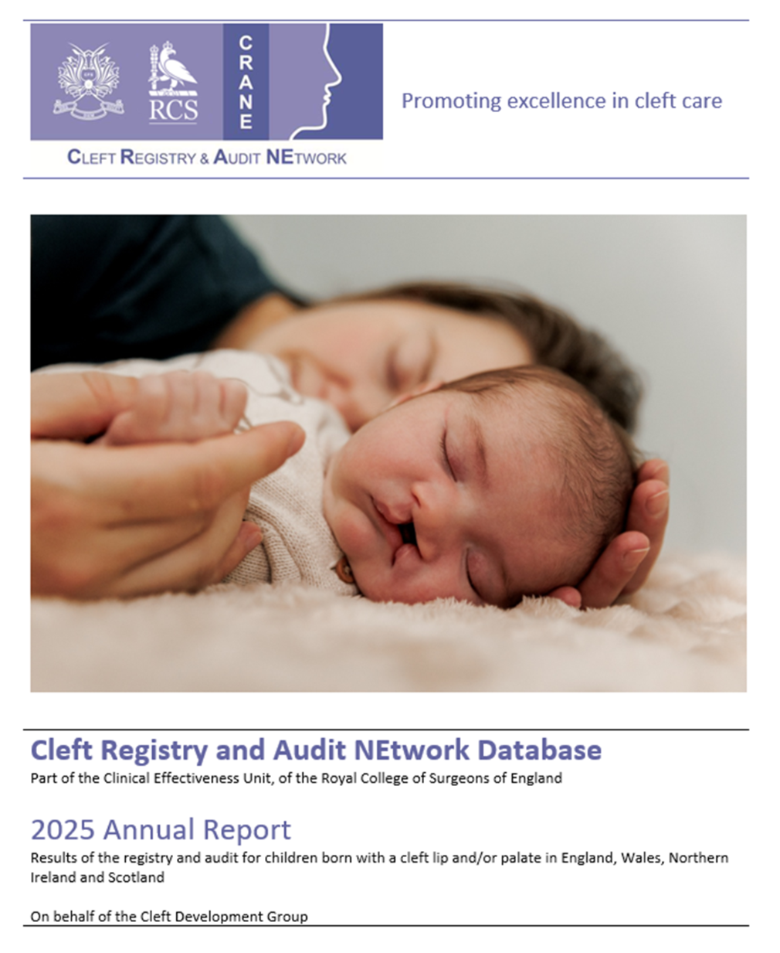
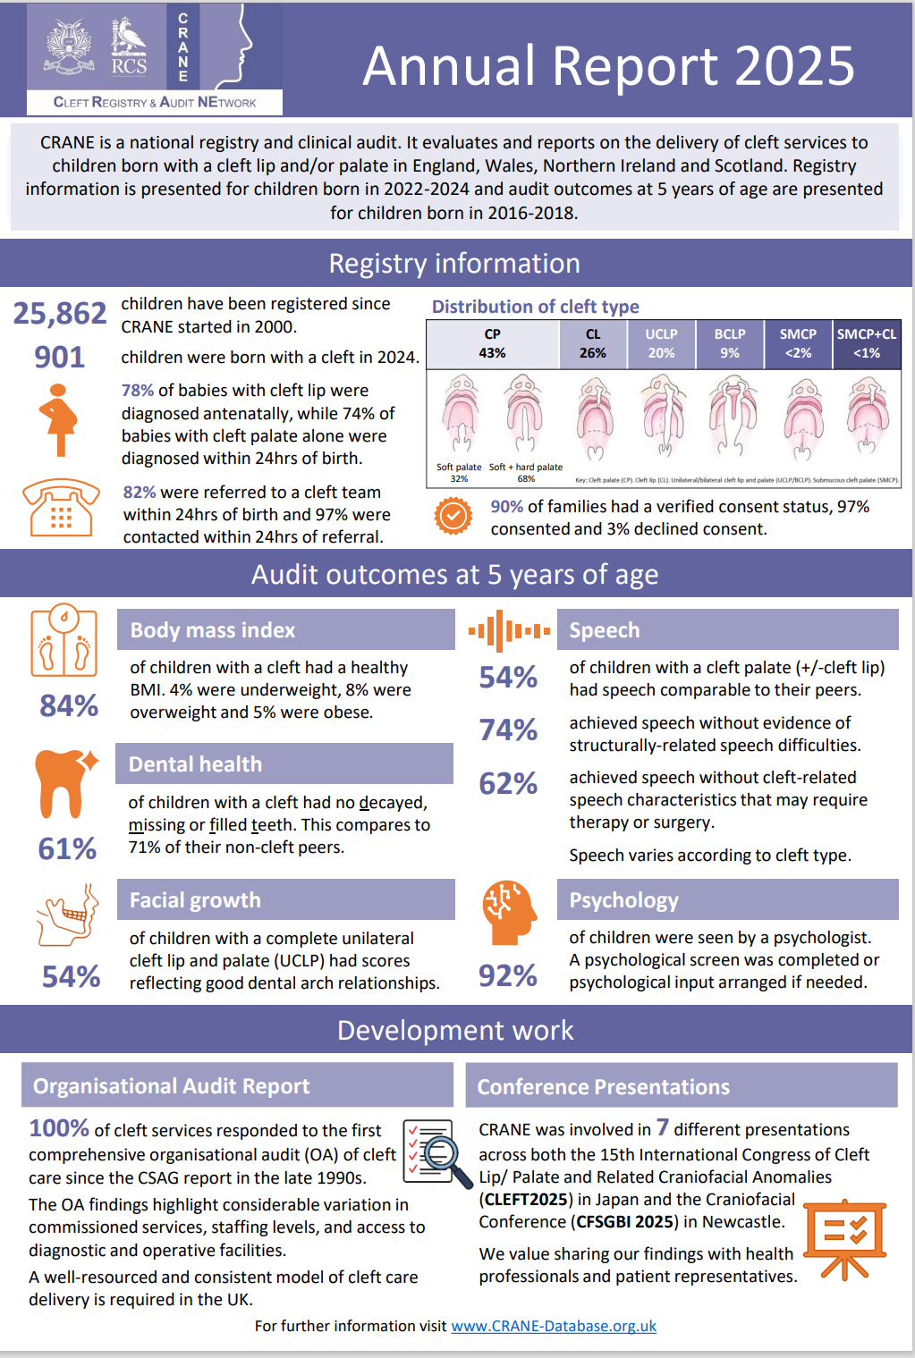
2025 Annual Report
Published December 2025
Key findings & recommendations
Registry information
Consent verification
5-year outcomes
Summary of organisational audit
Infographic
Supplementary tables
Outlier responses
Summary for cleft community
Notes:
Published 8 December
Contains 5 main sections
Alongside the report we also publish:
a one page summary infographic (as shown on the right)
Supplementary tables showing service-level data
All outlier responses from services
Summary for the cleft community, which was produced with input from CLAPA

Slide 5
Data completeness: Comparison with 2024 report
Notes:
How did data completeness compare with the 2024 report?
These charts show rates for early care indicators on the left and 5-year outcomes on the right. Blue bars show rates published in the 2024 report and the orange reflect the rates in the 2025 report.
No real change in data completeness for early care indicators
On the right we can see data completeness for 5-year outcomes is much lower than early care data items, but there have been improvements across all five measures, ranging from 11% increase in height/weight to 16% increase for speech.

Slide 6
Data completeness by year of birth
Notes:
These charts show data completeness by birth year included in the latest report. We can see rates are fairly consistent by birth year for early care data items, but for the 5-year outcomes (on the right) we can see for most outcomes there is improvement with each birth year, so hopefully we will see further improvements in the next annual report once we drop the 2016 birth year, which was potentially still affected by covid.
The blue dashed lines indicate what we should be aiming for.

Slide 7
Outcomes: Comparison with 2024 report
Notes:
These charts show outcomes by annual report and the circled items reflect changes greater than 1% between the two reports. Green circles represent better rates and red circles represent poorer outcomes.
For early care on the left, we can see improvements in 24hr CNS visits and improvement in verified consent rates.
For 5-year outcomes we can see a small improvement in the proportion with good facial growth scores,
but there was 3% drop in proportion of those meeting speech standard 1 and 3.

Slide 8
5-year-old outcomes by year of birth
Notes:
Looking at more detail by birth year in the included cohort, we observed a steady decline across each birth year in terms of standard 1 and standard 3. A difference of 7% percent in S1 and 5% for S3.
This decline and the variability in speech outcomes between services is why we chose to invite those services doing particularly well with speech to share their practices later on in this session.

Slide 9
New features in the 2025 Annual Report
Ethnicity: Reported for registry cohort and 5-year outcomes assessed for differences between white & ethnic minority groups
Antenatal contact/visit time: Included in report
Cleft service range: 54%-100% visited within 24h of antenatal referral
New supplementary table tab: Data completeness and outcomes by patient characteristics (birth year, cleft type, sex & ethnic group).
Transfers: 61 children transferring care between 2 months & 5 years excluded from service-level reporting due to potential differences in outcomes.
Notes:
Ethnicity introduced a few years ago. It has been added retrospectively for cases but data completeness not so great for 5-year old outcomes.

Slide 10
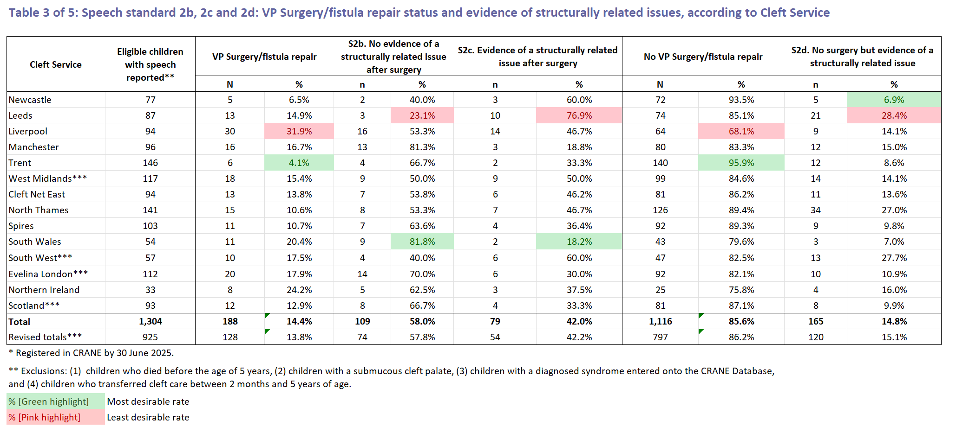
New features: speech standards 2b, 2c, 2d
Notes:
Now available in report, supplementary tables and publicly.
This information will help services see how they compare to others in terms of rates of secondary speech surgery and the outcomes of this.

Slide 11

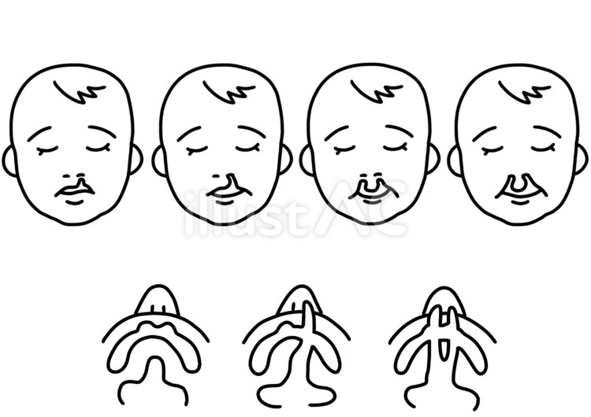


New features: risk adjustment
Risk adjustment of service-level outcomes introduced for speech & dental
Some units see:
More babies with additional medical conditions
More severe clefts
More boys than girls
More children from areas with higher deprivation
These factors affect outcomes before any treatment happens. CRANE adjusts for them so that differences between services reflect care quality, not patient mix.
Adjustment tries to level the playing field
Risk-adjustment is never perfect

Slide 12
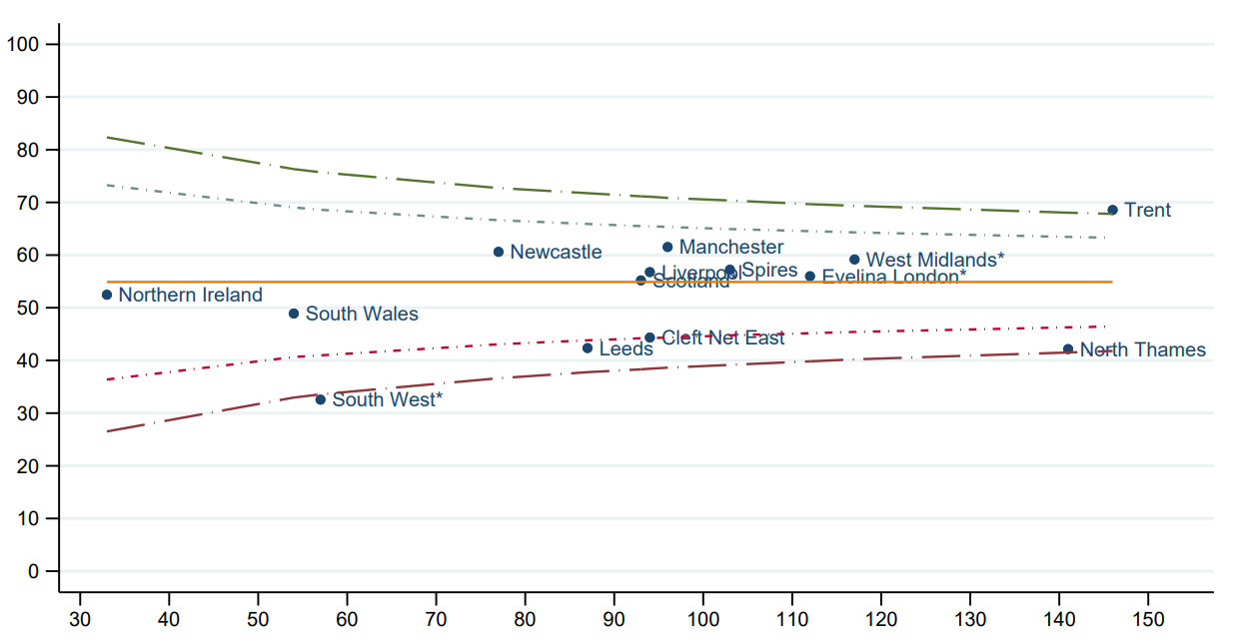
Risk adjustment process
Step 1: Multiple imputation of missing data for patient characteristics included in model
Step 2: Estimate each child’s expected outcome
Using national data, CRANE calculates the expected chance of a particular outcome for each child, based on their characteristics.
Step 3: Compare expected vs actual outcomes
For each cleft centre, CRANE looks at:
how many children were expected to have a particular outcome
how many actually had a particular outcome
Step 4: Produce adjusted centre-level results, presented in funnel plots
This allows CRANE to say whether a centre is performing:
better than expected (positive outlier)
as expected (within funnel)
worse than expected (negative outlier)
Notes:
MI – a statistical method for handling missing data. We apply models developed in our clinical effectiveness unit at the RCS. Imputing missing data means we’re not restricting our analyses to patients who have complete data across all items included in the adjustment models.
Observed data predicts the missing values. Several complete datasets are created.

Slide 13


Risk adjusted outcomes
Dental dmft
Deprivation based on postcode
Country (due to country-specific indexes for deprivation)
Robin Sequence status
Cleft type
Extent of palate involvement
Speech standards 1, 2a and 3
Cleft type,
Extent of hard palate involvement
Robin Sequence status
Sex

Slide 14
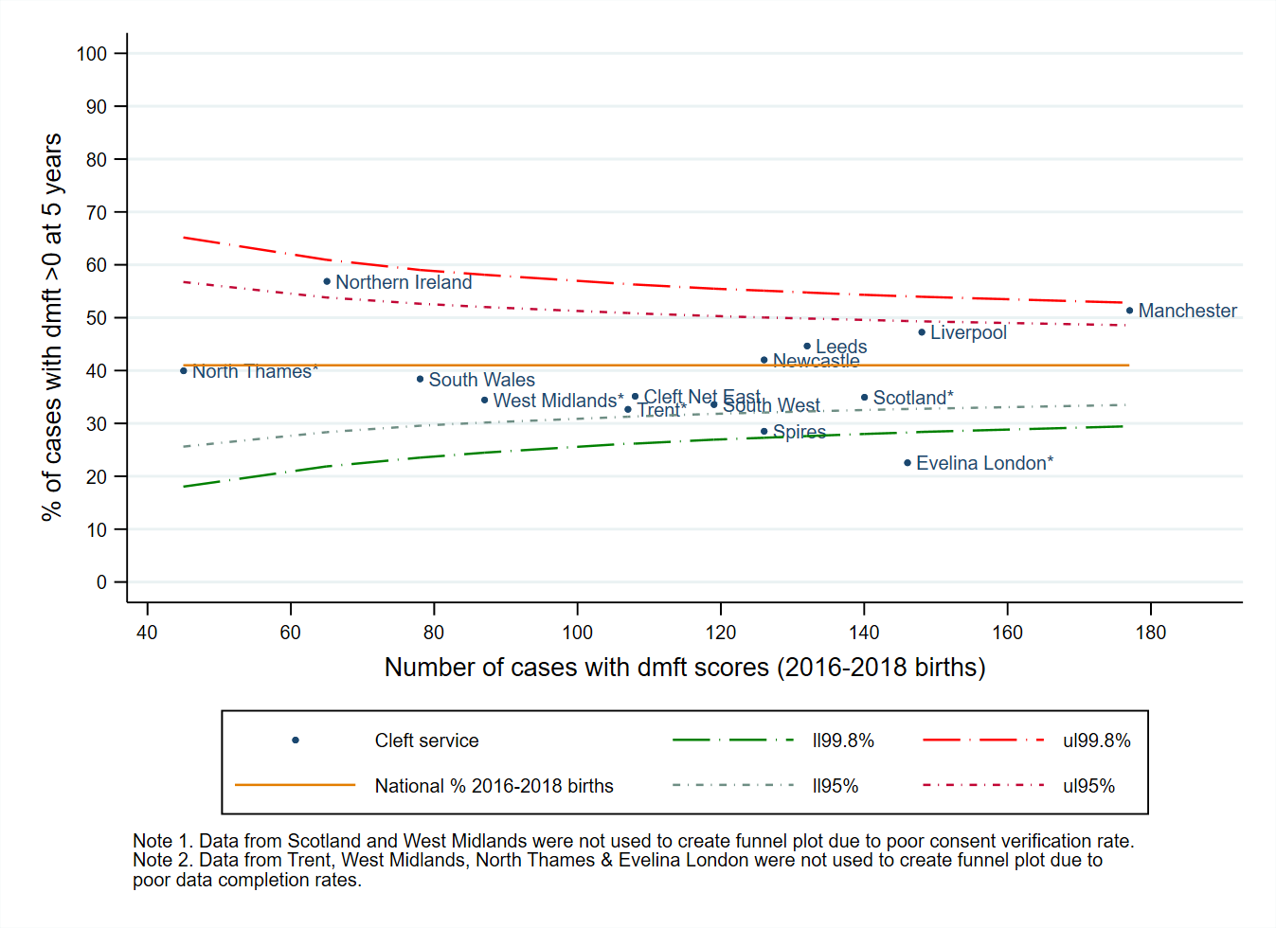
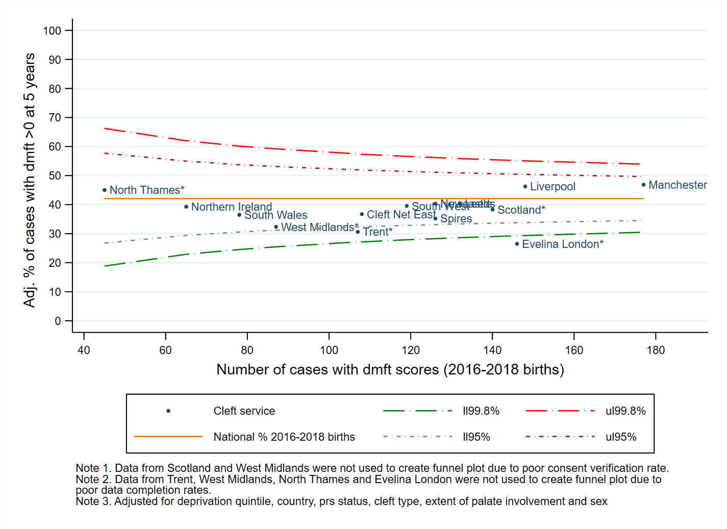
Unadjusted & adjusted rates: dental caries
Unadjusted dmft >0
Adjusted dmft >0
Notes:
Adjusted for Deprivation, country, RS, cleft type, extent of palate involvement,
The circles highlight services whose outlier status changed due to risk adjustment.
A larger difference was observed between unadjusted and adjusted rates in dmft outcomes than speech due to the inclusion of deprivation in the model.
It was not adjusted for in speech as modelling showed it not to be associated.

Slide 15
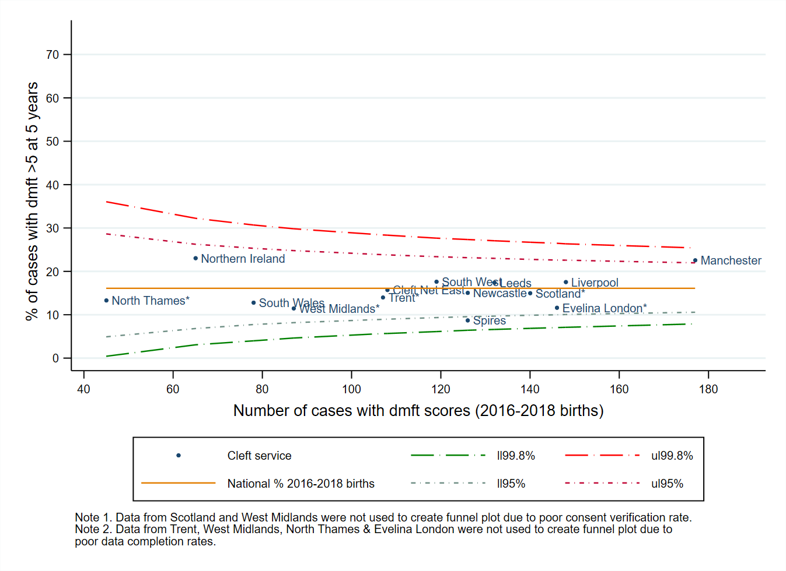
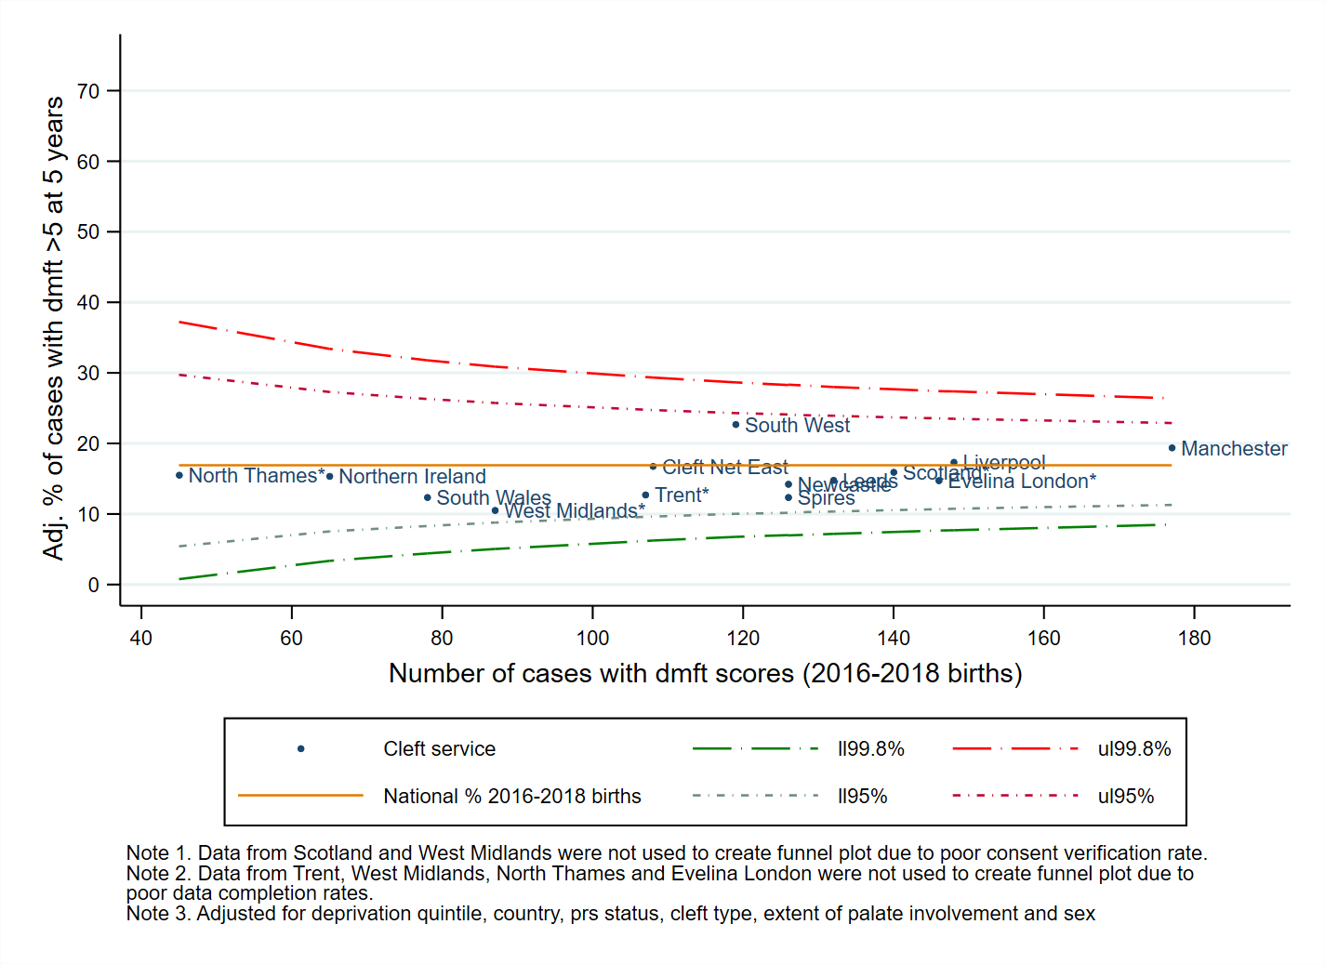
Extensive caries
Unadjusted dmft >5
Adjusted dmft >5
Notes:
No outliers once adjusted

Slide 16
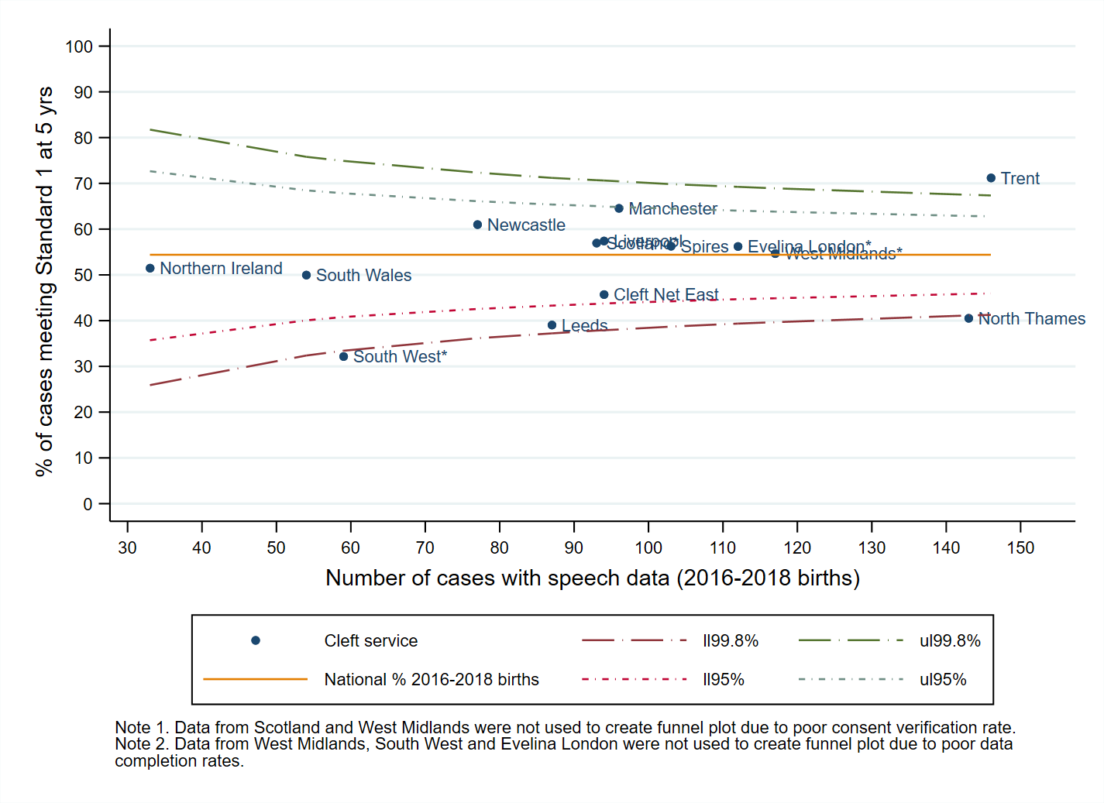
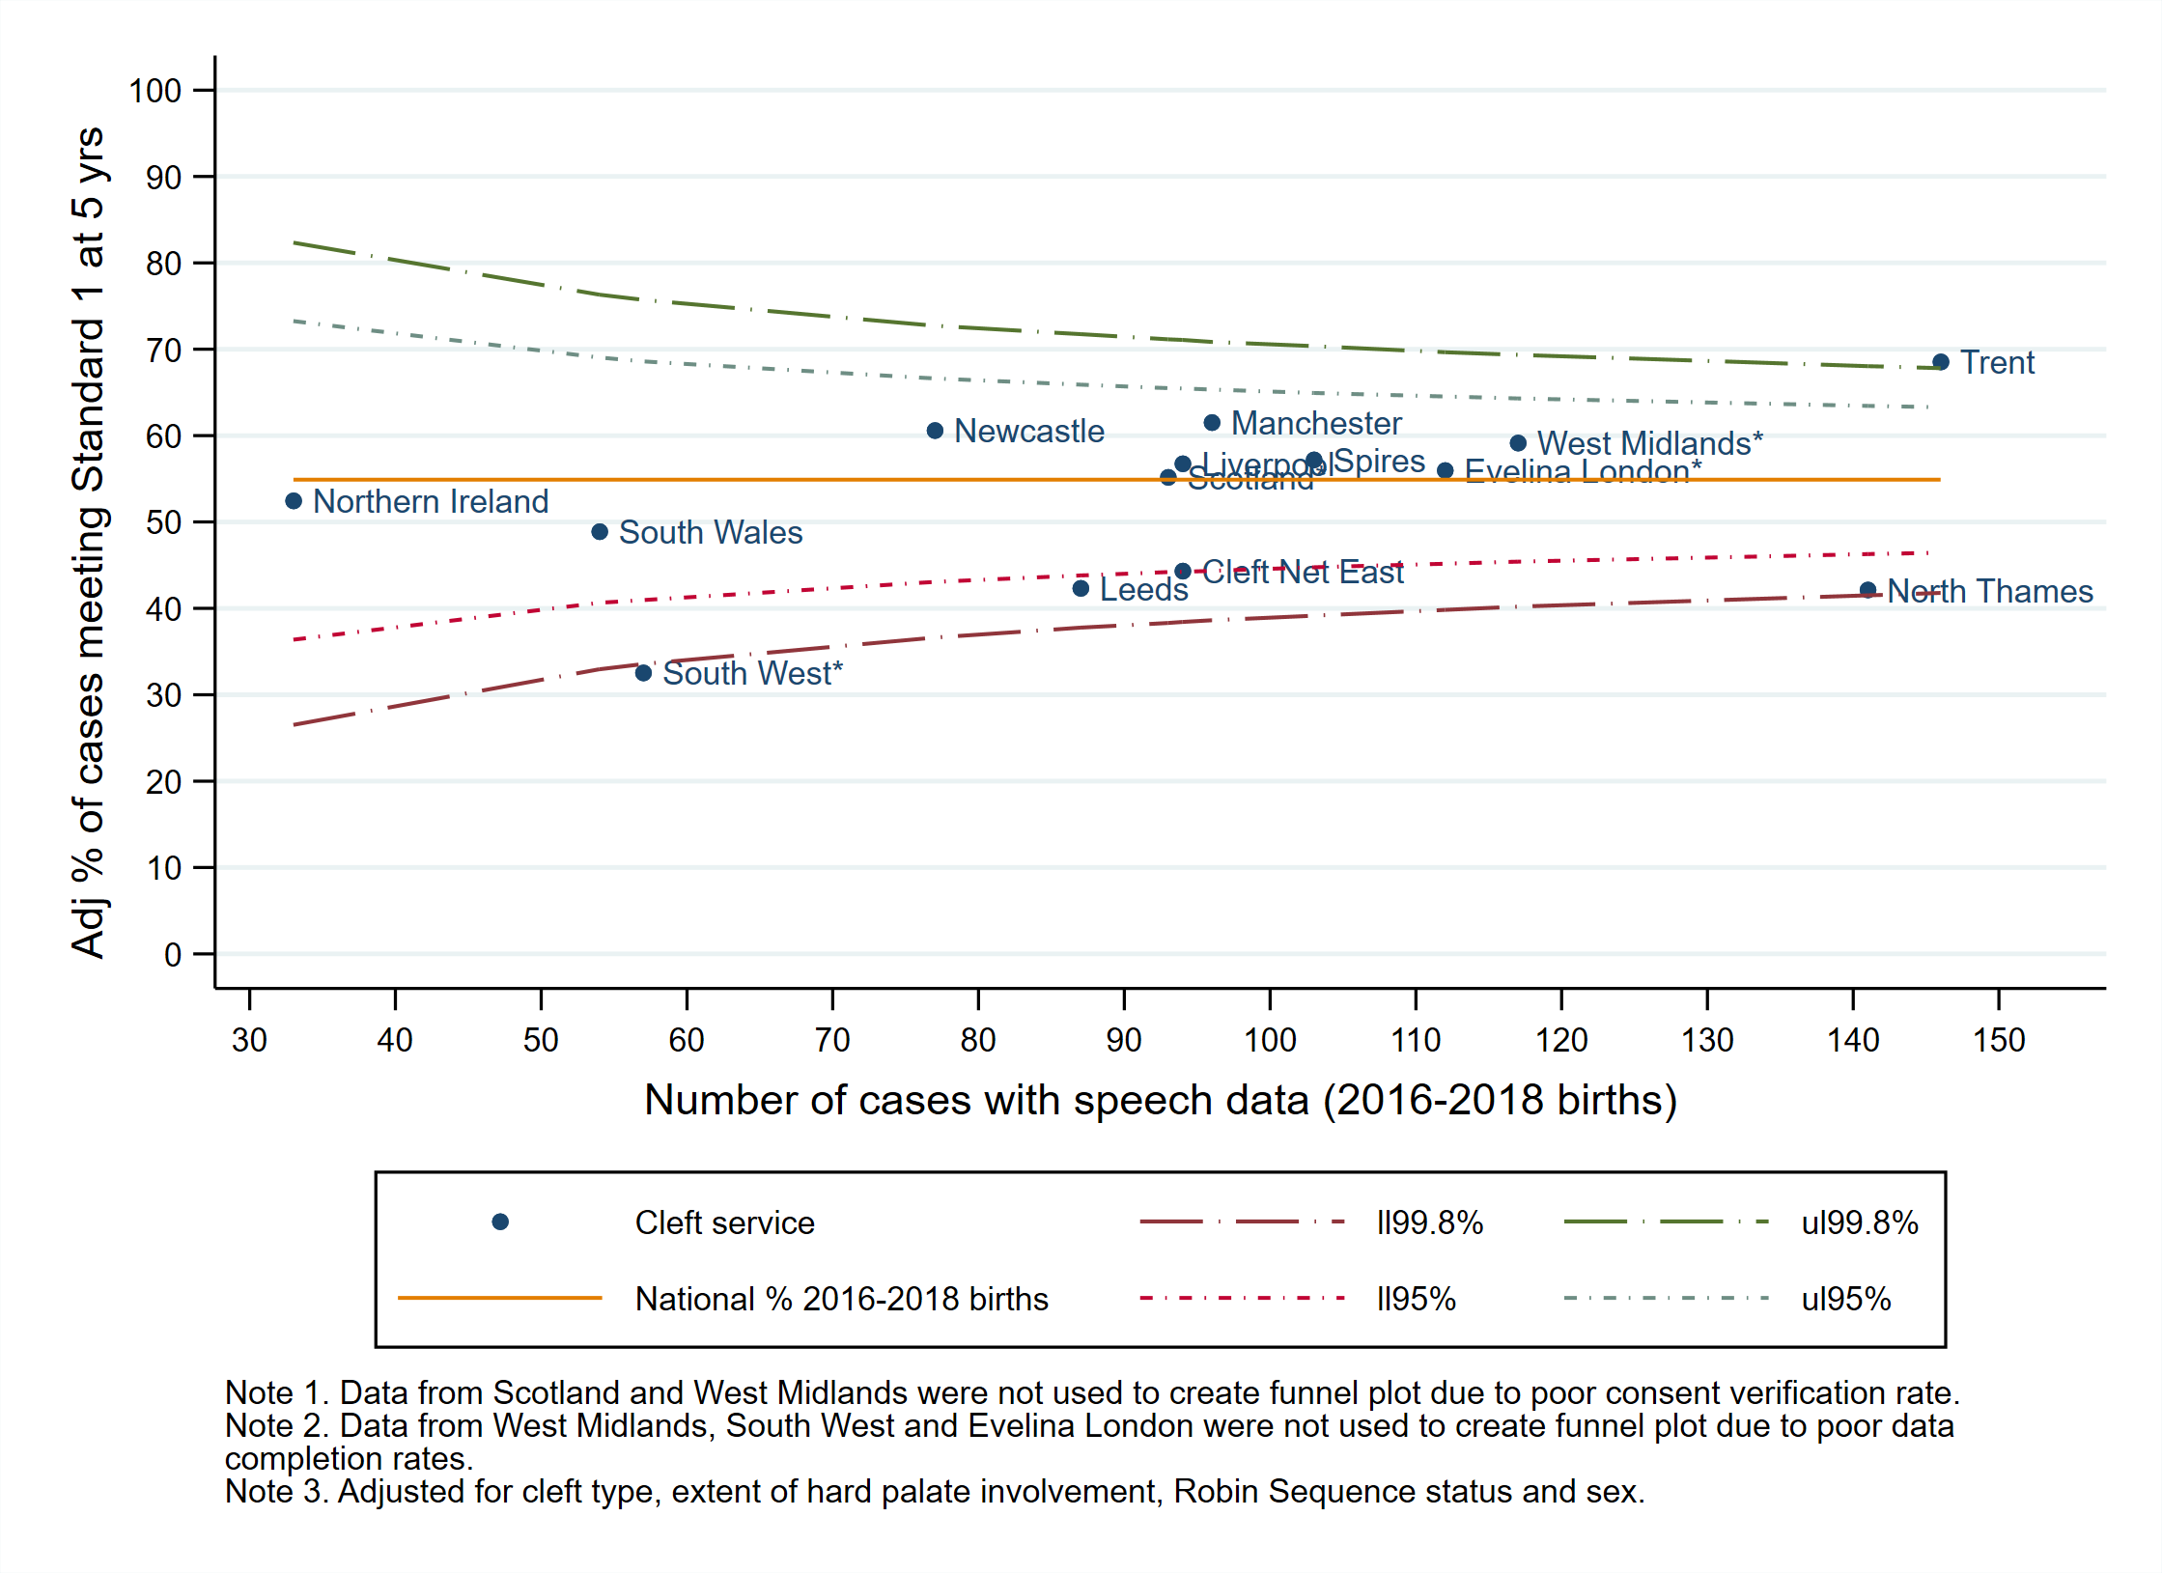
Speech standard 1: normal speech
Unadjusted speech standard 1
Adjusted speech standard 1
Notes:
Funnels show variation between services, even when adjusting for case mix.

Slide 17
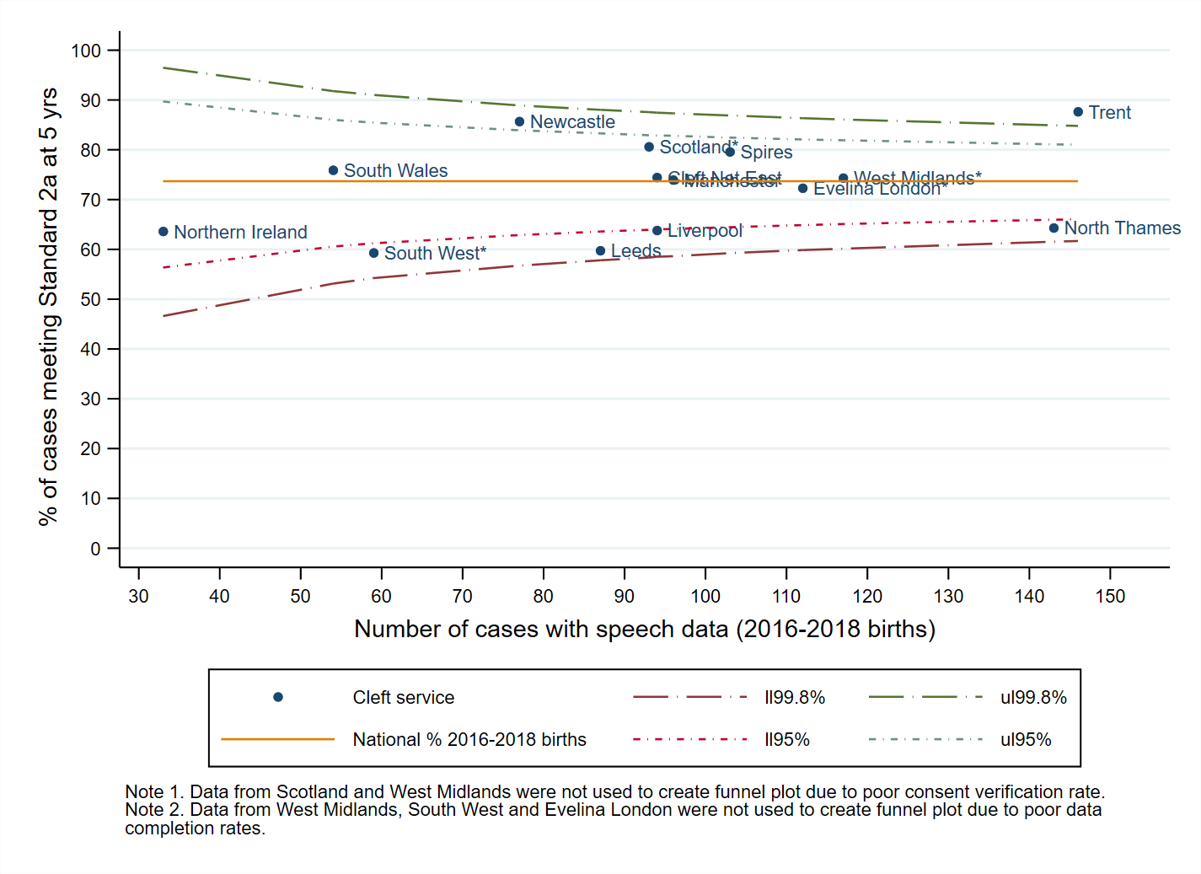
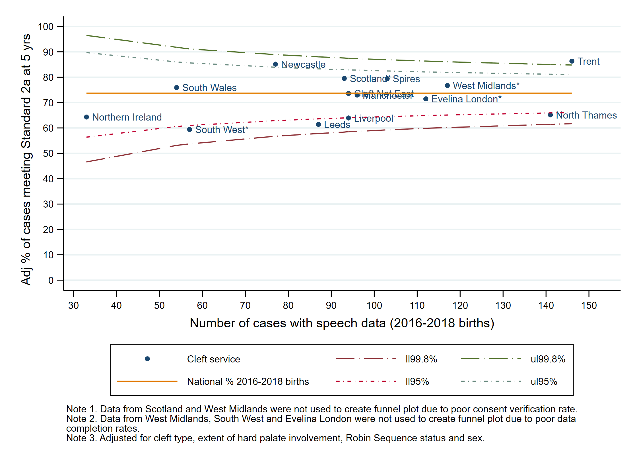
Speech standard 2a: No structurally related speech difficulties
Unadjusted speech standard 2a
Adjusted speech standard 2a
Notes:
No change in outlier/alert status

Slide 18
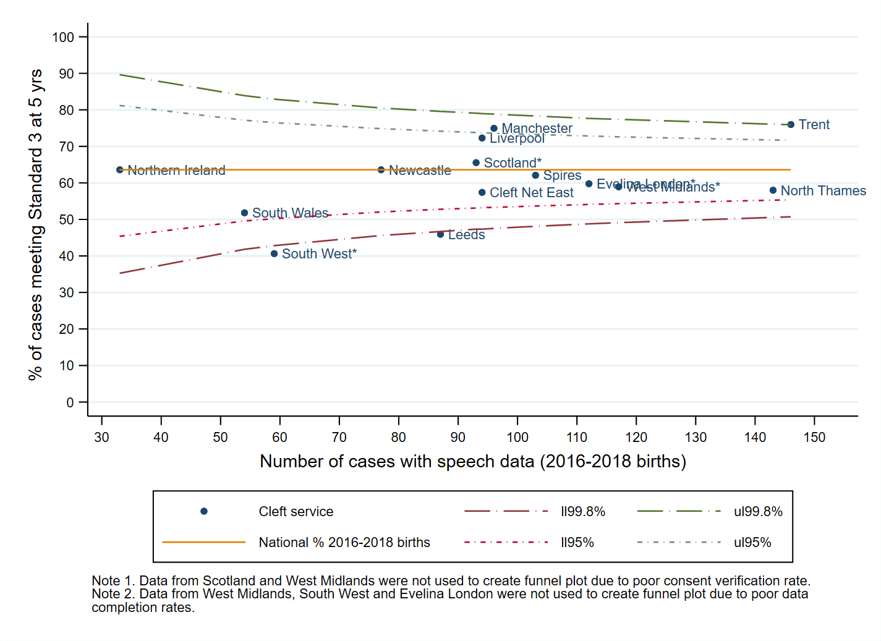
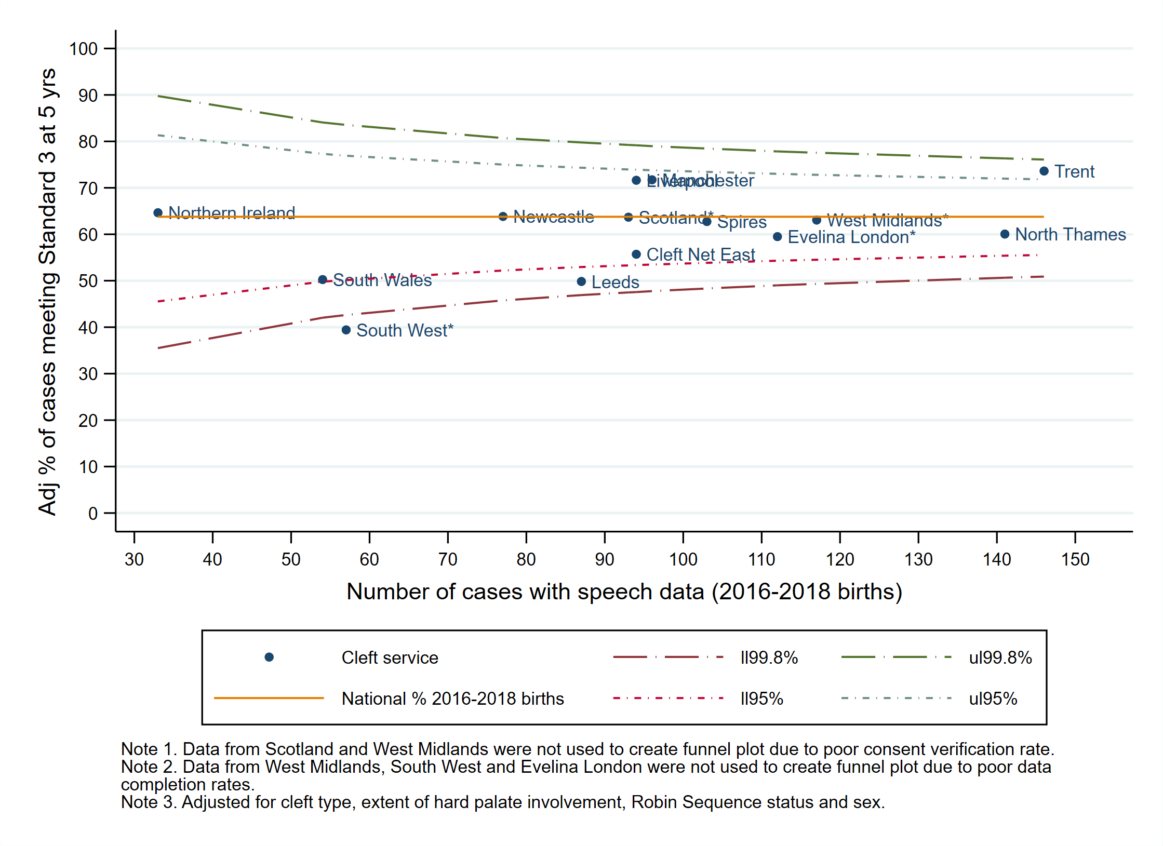
Speech standard 3: No cleft-related articulation difficulties
Unadjusted speech standard 3
Adjusted speech standard 3
Notes:
Three services had status that changed due to risk adjustment

Slide 19
New features: Outlier policy
Formal introduction this year
Indicators subject to outlier policy:
Consent verification (2016-2018 births)
Data completeness & outcomes at 5 years (2016-2018 births):
Growth
Dmft >0 & dmft>5
5-year old index
Speech standards x3
Psychology Tiers of Involvement Measure scores

Slide 20
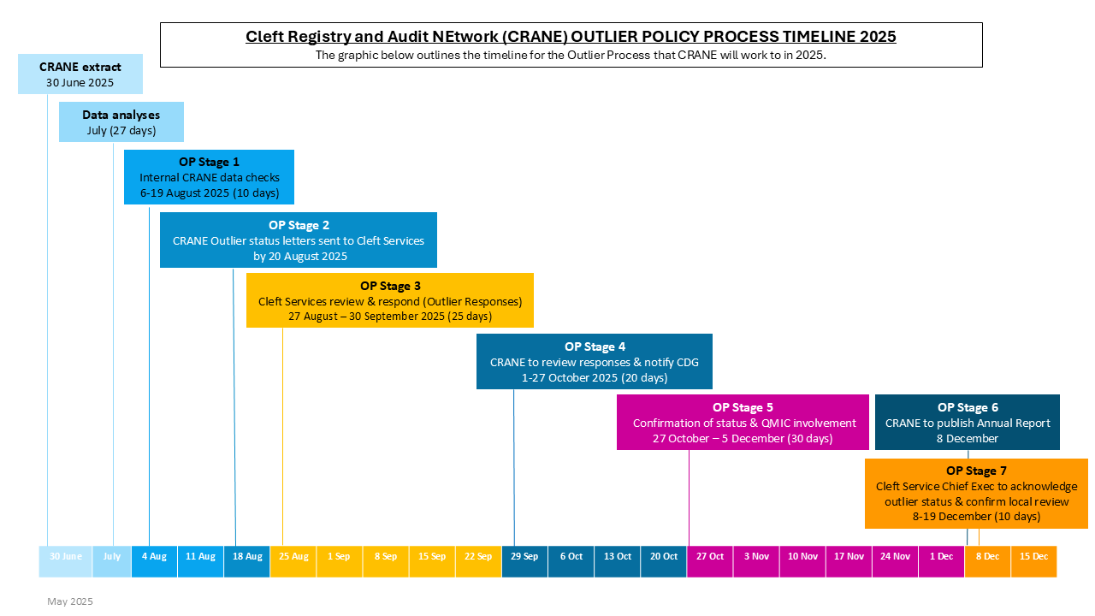
Outlier policy implementation

Slide 21
Outliers: All fourteen services received letters
All indicators (data completeness & outcomes)
Positive outlier status only: 2 services
Mixed positive and negative status: 10 services
Negative outlier status only: 2 services
5-year outcome indicators only: dental, speech & psychology
Positive outlier status only: 5 services
Mixed positive and negative status: 1 service
Negative alert only: 3 services
Negative outlier status only: 5 services
Notes:
All indicators (data completeness & outcomes)
Positive only: newcastle and Cleft Net East
Negative only: West Midlands & Spires
Outcome indicators
Positive only: Newcastle, Trent, Cleft Net East, Evelina London, Scotland
Mixed: Leeds
Negative outlier: Manchester, West Midlands, North Thames, South West (had positive alert too), Northern Ireland

Slide 22
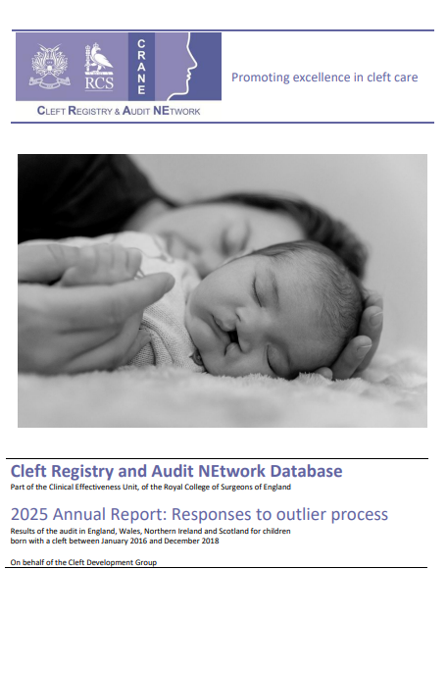
Learning from positive outlier responses
All services responded to outlier notification
Published alongside report
Reviewed responses from high-performing cleft services
Summarised key recommendations to support quality improvement
1. Data completeness
2. Clinical outcomes

Slide 23



Data completeness: good practice
1. Establish dedicated roles and processes
Dedicated data coordinators / admin support
Recruit or secure funding for full admin cover of data tasks - build business cases for admin posts using CRANE performance data
Cross-cover data roles to reduce risk
Protected audit time in job plans (nursing, admin, SLT, psychology)
2. Integrate data collection into clinical workflows
Preprepared consent packs and prompts to improve consent verification
Data collection embedded in MDT clinics
3. Continuous monitoring and integrated systems
Monitor completeness regularly - extract routine data snapshots for internal review meetings
Use integrated clinical and audit systems to flag outstanding consent & missing entries quickly
Note: where services struggled with missing data, lack of staffing was major factor

Slide 24
Dental: good practice
What High Performers Did Well
Paediatric dental team consistently attends 5‑year audit clinics, including spoke sites.
Active follow‑up for non‑attenders to secure dmft data.
Centralised audit clinics used by some services to maximise robust data collection.
Specialist/trainee dental support boosts performance and care indices.

Slide 25
Speech: good practice
What High Performers Did Well
Evidence-based surgical procedures + early outcome markers drive improvement
Early and repeated speech assessment embedded into care pathways
Close SLT-surgeon collaboration for early interventions
Long-term MDT culture of audit, shared learning and continuous improvement
Participation in national calibration

Slide 26

Psychology TIM1+ scores: good practice
What High Performers Did Well
Dedicated psychology staffing with protected audit responsibilities
Psychology consistently present at MDT audit clinics, enabling timely screening
Proactive identification and invitation of eligible children to audit clinics
Regular validation of TIM scoring to correct inaccurate zero scores

Slide 27

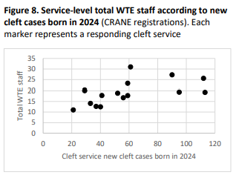
Overview of Organisational Audit findings
Service Structure and Configuration
100% response rate from all Cleft Services
60% of services led by surgeons
Most services operate across multiple sites (average: 5 sites)
Wide variation in commissioned services, staffing levels, and access to diagnostic and operative facilities
Funding and Sustainability
Many services deliver unfunded elements of care, raising concerns about long‑term sustainability
Inequity exists between services in terms of WTE (funded + unfunded) staff members and new cleft cases
Workforce shortages common, particularly in Psychology, Orthodontics and Paediatric
dentistry
Equity of Access
Ongoing challenges in equitable access across geography and specialties
Paediatric dentistry and speech & language therapy are areas of particular concern
CRANE Organisational Audit Report 2025 - CRANE Database

Slide 28
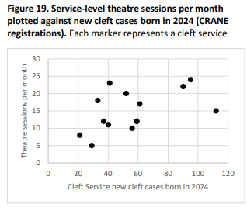
Organisational Audit
Detection, Referral, and Early Care
80% of services reported concerns about delayed detection or referral of clefts
Only 40% felt adequately funded to train external professionals (e.g., midwives, health visitors)
Surgical Timelines
Most services aim to repair:
Lip by 3–4 months
Palate by 9 months
However, 33% reported delays to these timings during 2024
Use of the CRANE Database
High levels of engagement with CRANE
CRANE valued for:
Benchmarking
Quality improvement
Supporting service development

Slide 29
Organisational Audit conclusion
Unique resource when combined with Annual Reports
Early improvements have remained relatively static
Significant variation in cleft care delivery
Significant variation in outcomes
Much more can be achieved by learning from the most efficient and effective services
WEE can do it together!
Notes:
This sets the scene for the next section of the webinar where we’ll be hearing from services doing particularly well in certain areas.

Slide 30
Learning from good practice Invited speakers
Notes:
If I could ask each presenter to select the ‘take control’ button at the top of the screen when it’s their turn to present. You should be able to move through the slides. At the end, please just wait for the next person to ‘take control’.
Please do not select ‘stop presenting as this will close down the presentation for everyone. If there are any issues with moving through the slides, we can always do a Chris Whitty and move forward on your behalf.
Our first presenter is Jenny

Slide 31
Early diagnosis

Slide 32
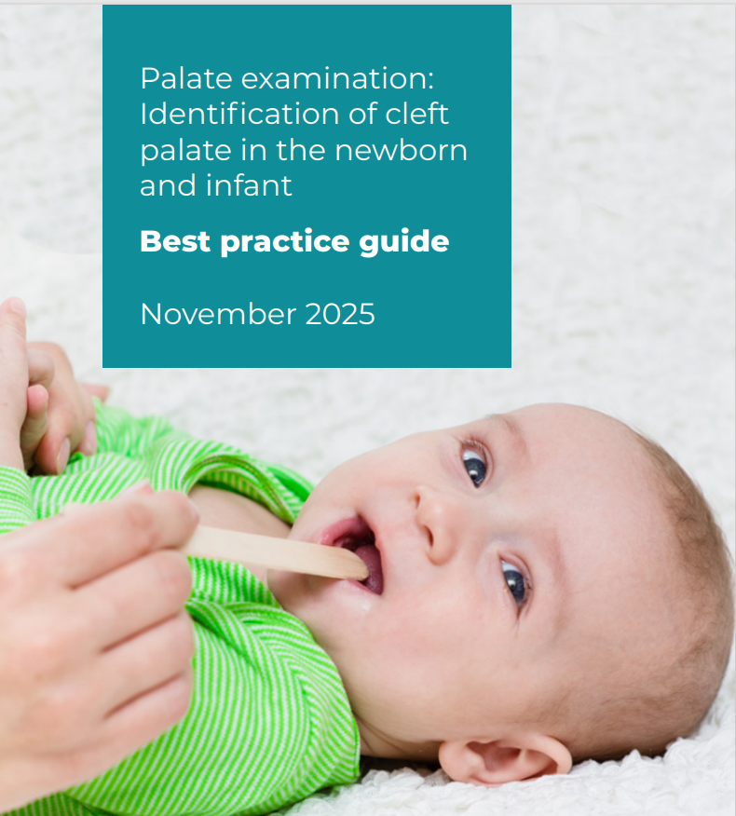
Updated guidance from RCPCH
6 Key recommendations
Healthcare professionals should examine an infant’s hard and soft palate as part of Newborn and Infant Physical Examination (NIPE) and record this in the SMaRT4 NIPE (S4N) live system or GP IT system.
Examination of an infant’s palate should be carried out by visual inspection.
A torch and method of depressing the tongue should be used to visualise the whole palate.
Parents should be informed if the whole palate (including the full length of the soft palate) has not been visualised during the NIPE.
If the whole palate is not able to be visually inspected at first attempt then a further attempt at visual examination should be made within 24 hours.
Trusts should provide training on the correct method of visual inspection of the palate to all healthcare professionals required to carry out the NIPE.
Palate examination: Identification of cleft palate in the newborn - best practice guide | RCPCH
Notes:
Just to highlight that the palate examination guidance from RCPCH has been updated
If I could ask each presenter to select the ‘take control’ button at the top of the screen when it’s their turn to present. You should be able to move through the slides. At the end, please just wait for the next person to ‘take control’.
Please do not select ‘stop presenting as this will close down the presentation for everyone. If there are any issues with moving through the slides, we can always do a Chris Whitty and move forward on your behalf.
Our first presenter is Jenny

Slide 33
Cleft Palate Diagnosis in Scotland
Jenny Pettigrew Cleft CNS Lead

Slide 34
2022-2024 births
80% diagnosed <24 hours of birth
90% diagnosed < 72 hours of birth
Scotland has 14 healthboards
Babies can be delivered in 47 hospitals (29 midwife led units).

Slide 35
What do we do – Raising Awareness
Hospital teaching
University teaching (pre reg midwives, post reg - neonatal course, HV)
NHS Education for Scotland (NES) webinar (also recorded and available to watch on demand).
Virtual session with national group for infant feeding advisors
Link in each unit, we contact yearly to offer teaching, send updated information.

Slide 36
Share case studies with photos
Share lived experience through video and open letter.
Use palate moulds
Encourage RCPCH e-learning module detecting cleft palate early

Slide 37
Feedback
Feedback to unit when cleft palate diagnosis late, offering teaching.
One hospital now has a face to face teaching session every 6 months, with rotation of medical staff

Slide 38
Questions?

Slide 39
CRANE: Making it Better
Diagnosis of cleft palate within 72 hours of birth
Emma Glass – Lead CNS
Kate le Maréchal – Head of Service
21 January 2026

Slide 40
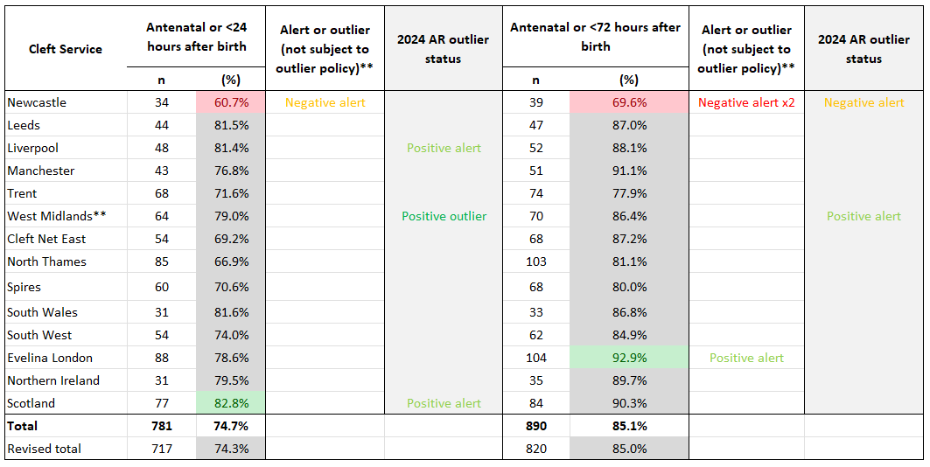
Table 1 of 2: Number of CRANE-registered* children born with a cleft palate alone (CPO) in 2022-2024, according to diagnosis time and Cleft Service (Excludes babies born <34 weeks' gestation)
Notes:
**Revised totals have excluded West Midlands due to being a negative outlier for reporting diagnosis time

Slide 41
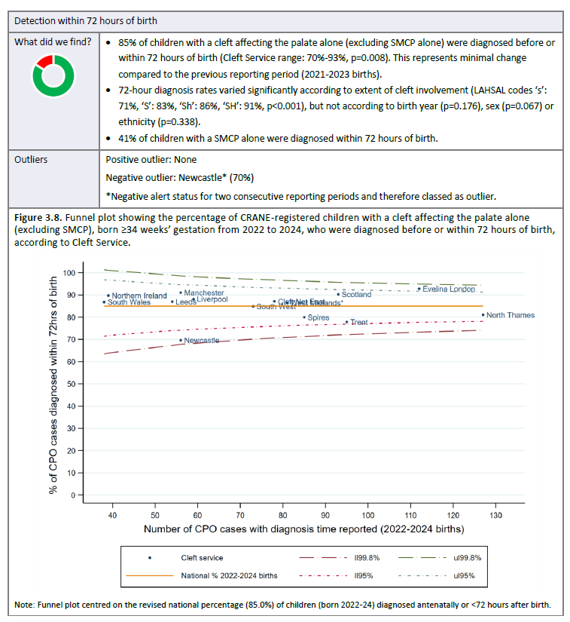

Slide 42

Diagnosis of cleft palate within 72 hours of birth
Cleft is “on the radar” across our patch Strong, longstanding relationships with maternity, foetal medicine and neonatal teams mean that cleft is actively looked for and flagged early. Staff know who we are and how to reach us.
Routine reinforcement of palate examination skills We invest in refresher training for midwives and neonatal staff, particularly around confident examination of the palate. This includes:
targeted teaching following any “missed baby”
visual prompts (posters, cards)
embedding palate examination into newborn documentation and proformas
Low-threshold referral culture Our message is simple: if in doubt, refer. Enquiries are welcomed and never criticised or “bounced”, which reduces hesitation and delay.

Slide 43
Diagnosis of cleft palate within 72 hours of birth
Systems that support rapid confirmation and recording Once a baby is flagged, our pathways enable timely specialist assessment and prompt CRANE entry. Good data capture both reflects – and reinforces – timely diagnosis.
Crucially: a CNS service that works weekends Babies born or identified on a Friday do not have to wait until Monday. Weekend CNS cover means that suspected cleft palate can be assessed, confirmed and recorded within the 72-hour window.

Slide 44
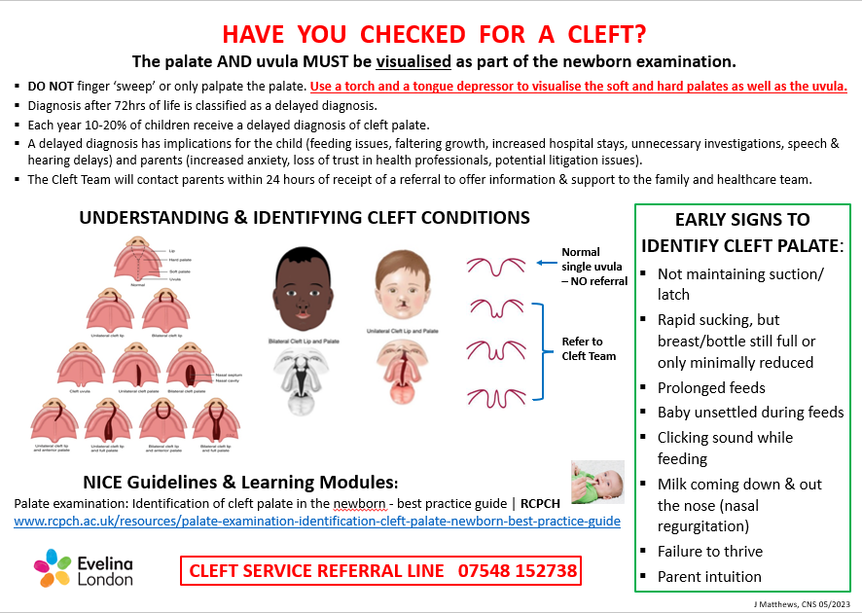

Slide 45



Slide 46
Treatment approach for positive speech outcomes

Slide 47
The Trent Team approach to speech
Trent Regional Cleft Network

Slide 48
The ask
Trent’s surgical approach to primary palate surgery, covering preoperative optimisation, perioperative management, timing and technique
Trent’s approach to speech therapy and reflections/explanations for differences in speech articulation outcomes between Trent and centres with comparable palatal function.

Slide 49
The delivery
Pre/peri-operative optimisation
Surgery
Supporting speech

Slide 50
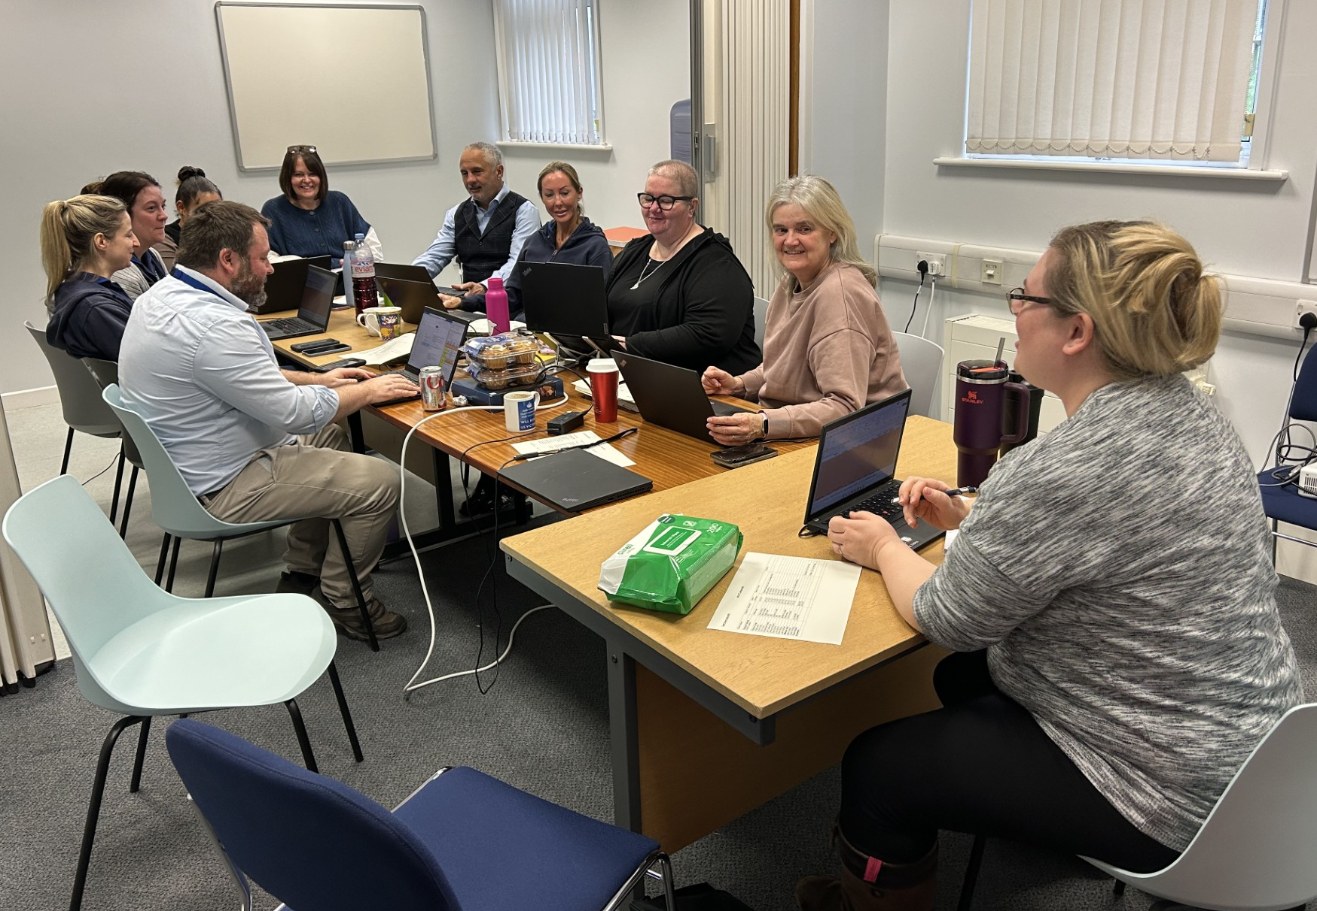
Pre/peri-operative care
Diagnosis visit - CNS
Home care - CNS
New Baby clinic – CNS, Paediatrician, Surgeon
Pre-admission clinic – CNS, Anaesthetist, Surgeon
Monthly MDT patient review
Home care - CNS
Surgery
1 week Postoperative visit - CNS
3 months postoperative review – SLT, Surgeon

Slide 51
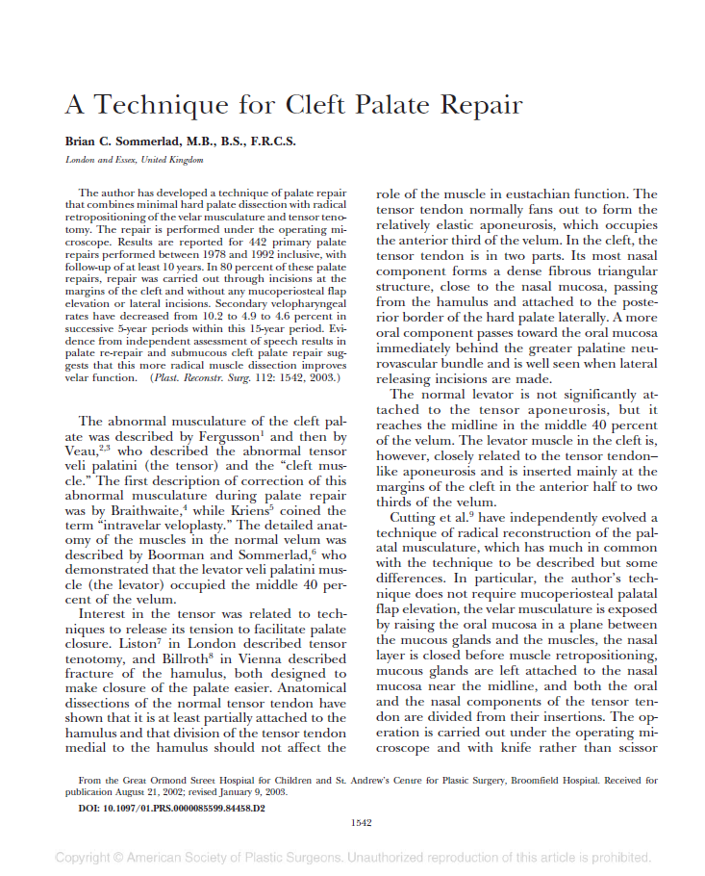
Surgery
Plastic and Reconstructive Surgery

Slide 52
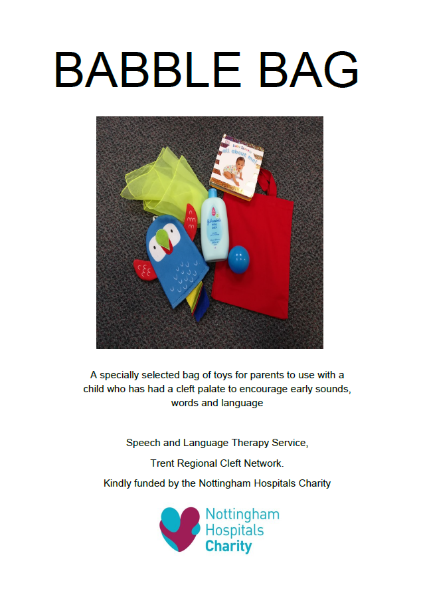

Early proactive SLT support

Slide 53

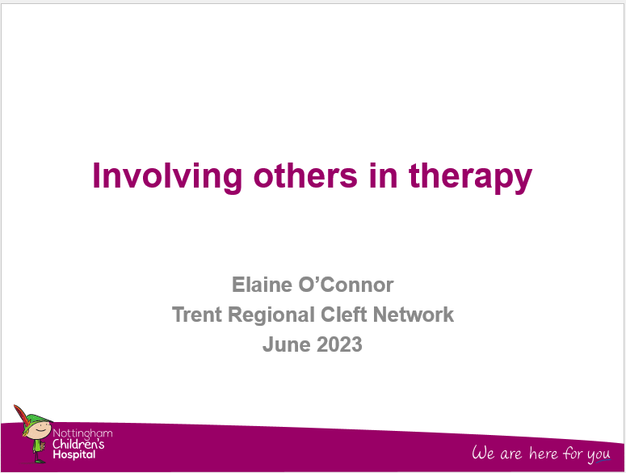
Broadening the therapeutic environment

Slide 54
Variety of SLT
REDACTED IMAGES

Slide 55
SLT review pathway
3 months postoperative review – SSLT, Surgeon
Babble advice session – Link SLT
Speech MDT – SSLTs, Surgeons
Therapy – SSLT, Link SLT
Surgery - surgeon
18-24/12 speech assessment - SSLT
Therapy – SSLT, Link SLT
3-year-old speech assessment - SSLT
5-year-old Audit MDT – SSLT, Surgeon, others

Slide 56
Summary
Ensuring “thriving” babies – CNSs/Paediatricians
Accurately delivered reliable surgical technique to optimise healing and outcomes – Surgeons/Anaesthetists/Nurses
Encourage a speech rich environment, close monitoring, and timely support – Parents/SLTs/others/Surgeons

Slide 57
Secondary surgery for positive speech outcomes

Slide 58


Approach to secondary speech surgery
Dave Drake
Consultant Cleft and Maxillofacial Surgeon
Royal Hospital for Children, Glasgow
Previously
Morriston Hospital, Swansea
(2005 to 2018)
Helen Extence
Lead Speech and Language Therapist
Morriston Hospital , Swasnea

Slide 59



Slide 60
Why have I been asked to speak
20% of children in South Wales had secondary speech surgery.
Of these, 82% had no evidence of a structurally-related issue after surgery (national average: 58%, cleft service range: 23%-82%)
Not just about speech surgery but how a Cleft MDT of surgeon and speech therapists achieve good results
Helen Extence and the speech therapy team in South Wales
(and the rest of the cleft team)

Slide 61
Palate Repair- my approach
Ideally at 6 months Before 1 year
Functional reconstruction of muscles
Maintain palate length
Minimise fistulas
If UCLP/BCLP then should have anterior hard palate repaired with a vomer flap at time of lip surgery if possible

Slide 62
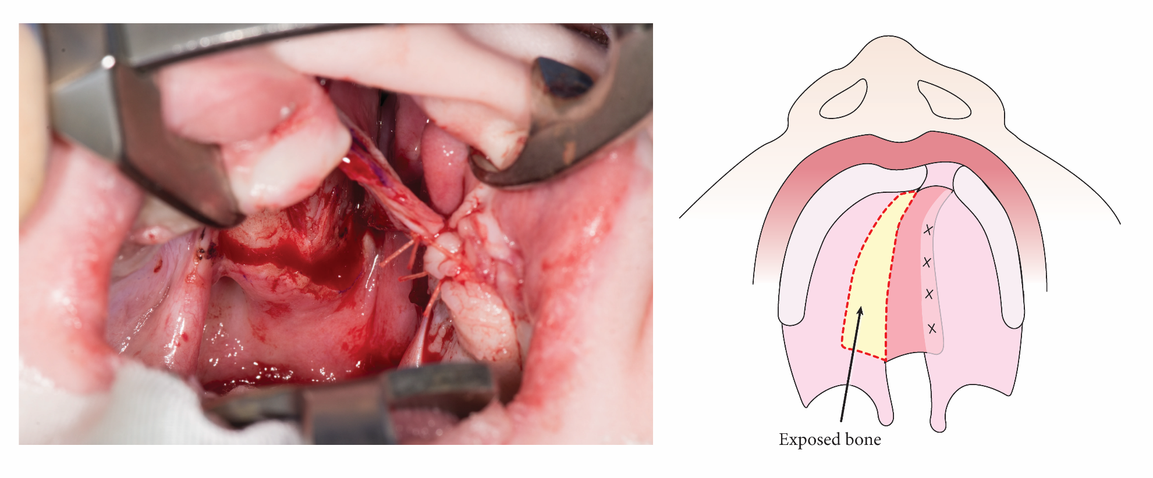
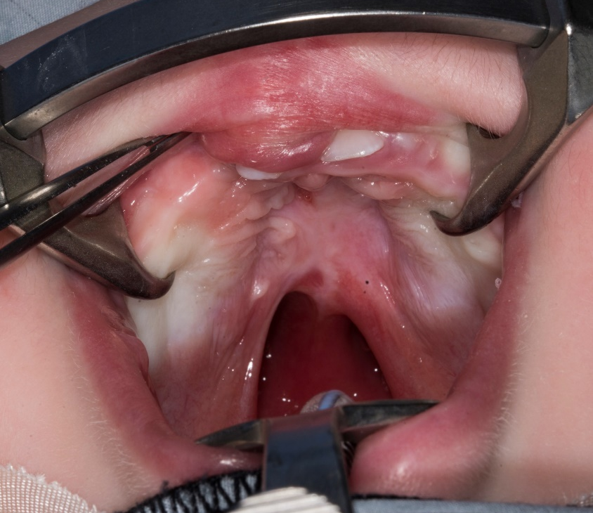

Slide 63
Palate Repair –my approach
Aims
Robust 2 layer closure hard palate and 3 layer closure soft palate
One surgery not staged

Slide 64
Palate Repair
Intravelar veloplasty
Sommerlad type repair
Modified Von Langenbeck approach
Keep lateral releases to a minimum

Slide 65
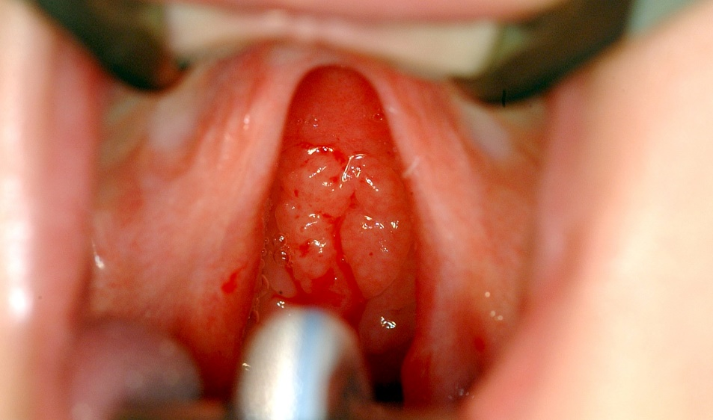
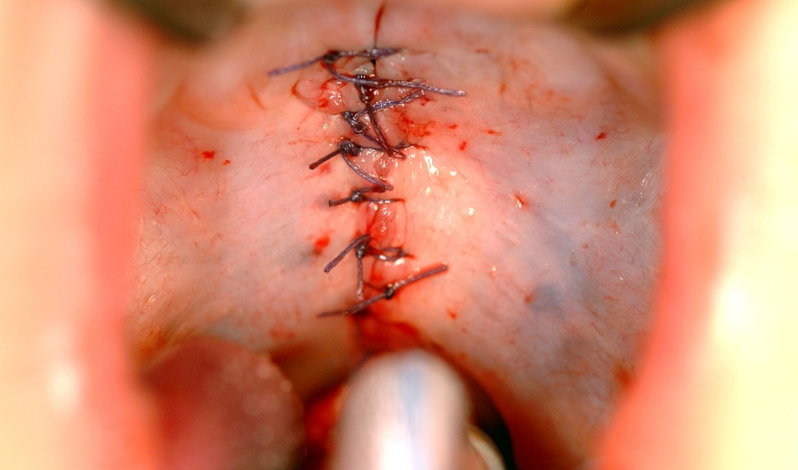
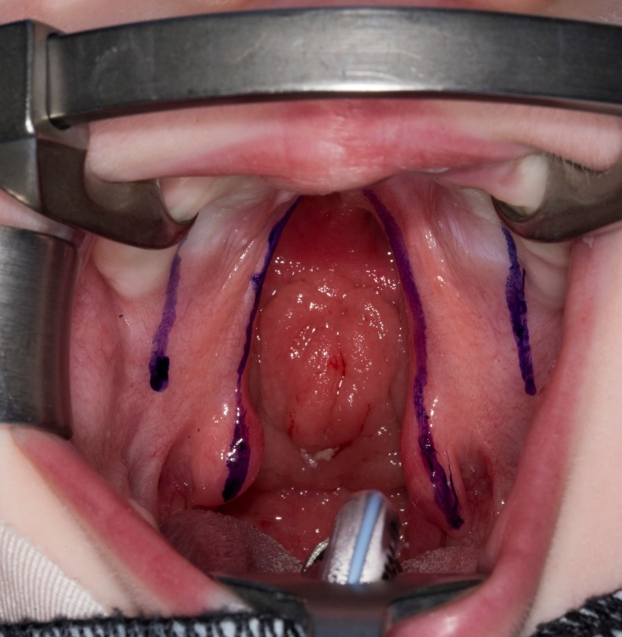
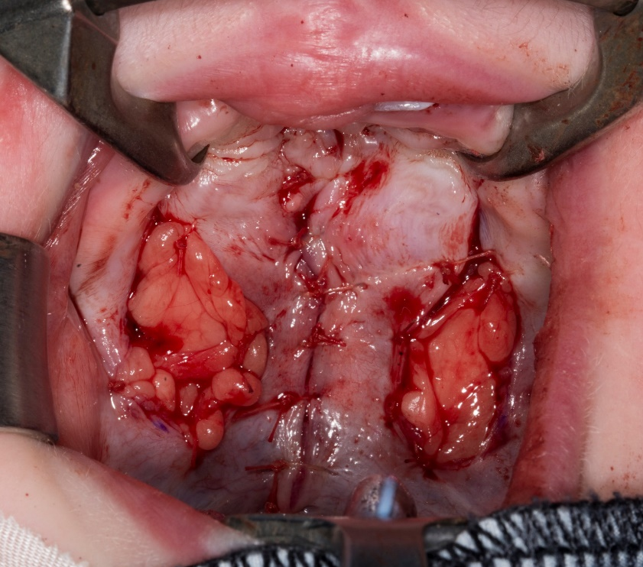

Slide 66
Post surgery speech review
Close well managed speech review at 18 months and 3 years
High risk patients ( BCLP and wide palates) additional review at 2
Aim to reduce delays and quick decision making
Evidence of significant VPD at 18 months 2 or 3 then for review and treatment

Slide 67
If structural problems palate (20%) determined clinically and /or radiographically
Short palate
Anterior muscle lift
Palate rerepair treatment of choice
Repeat muscle dissection and lengthen palate with posterior pillar extensions
Review of 60 consecutive cases
80% successful

Slide 68
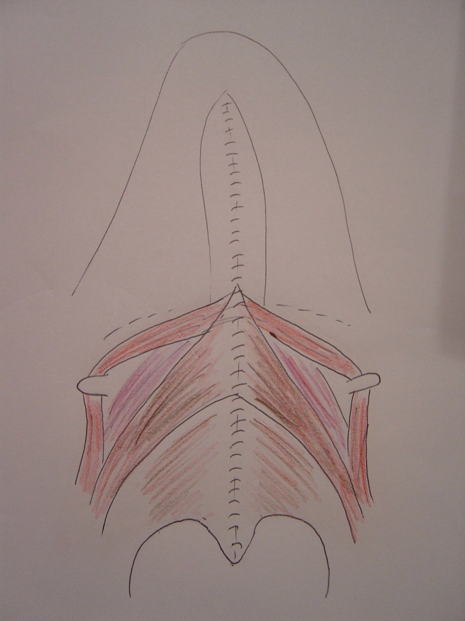
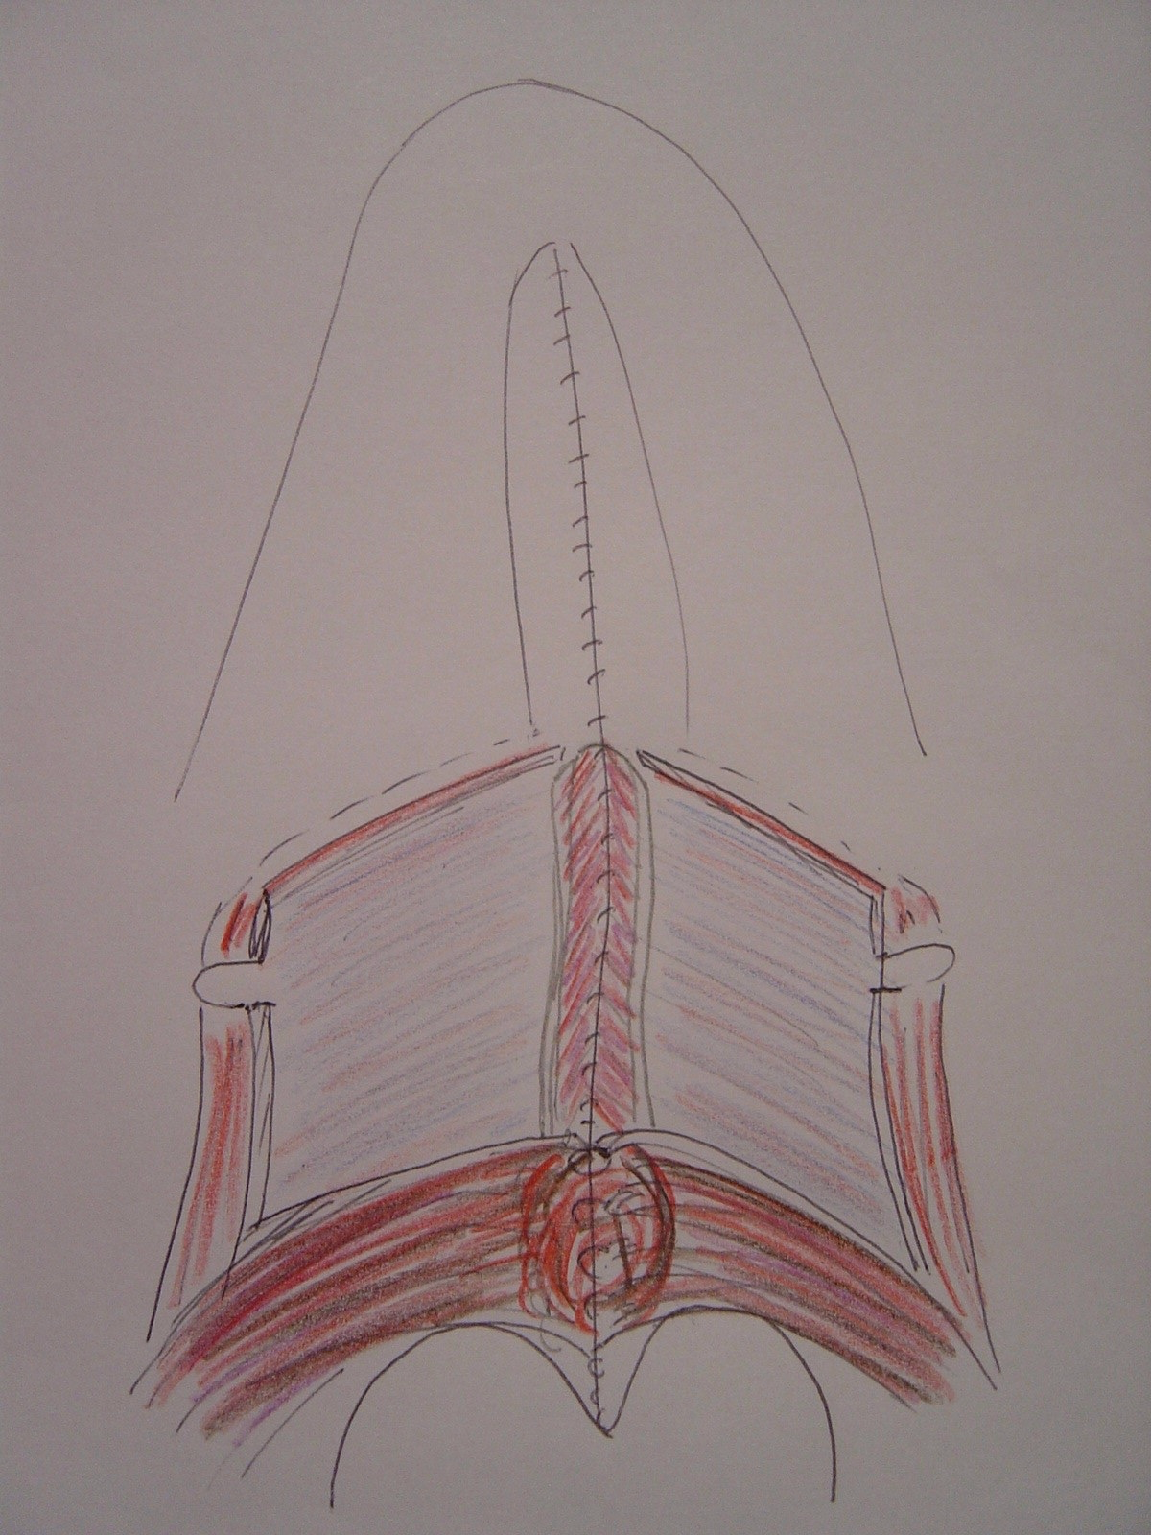

Slide 69
If palate rerepair not indicated or it hasn’t been successful
Orticochea pharyngoplasty Jackson modification
Most patients dont need this - only 4%
Those that do 95 % successful

Slide 70
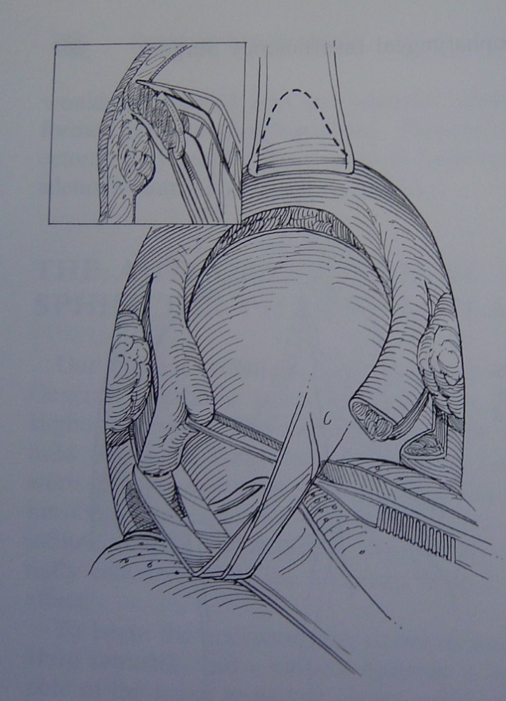
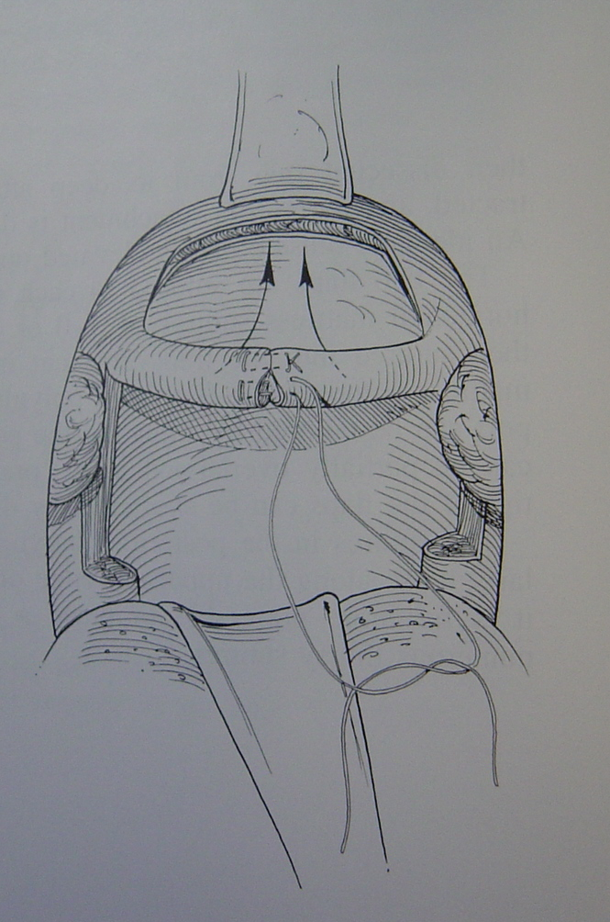
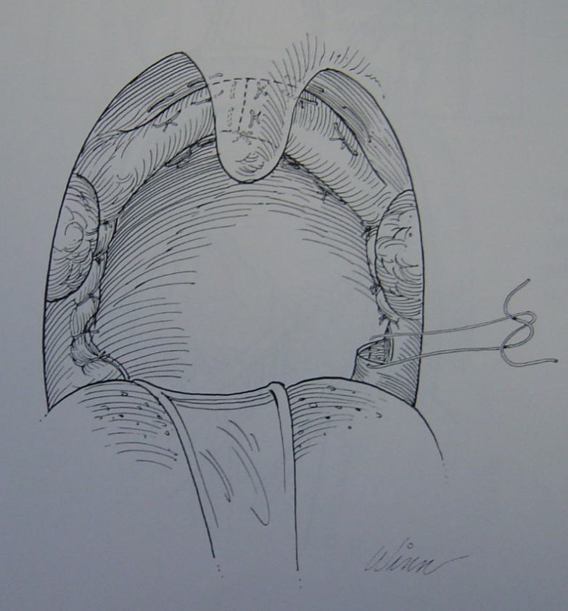

Slide 71
Summary points
Good primary functional surgery with minimal scarring
Efficient diagnostic speech therapy
Quick decision making and good use of simple rerepair technique
Above highly effective in vast majority of cases

Slide 72
Crane Making it Better Approach to secondary speech surgery
Victoria Beale
Consultant Oral and Maxillofacial Surgeon
Melanie Bowden
Lead Speech and Language Therapist

Slide 73
17% of children in Manchester had secondary speech surgery.
Of these, 82% had no evidence of a structurally-related issue after surgery (national average: 58%, cleft service range: 23%-82%)

Slide 74

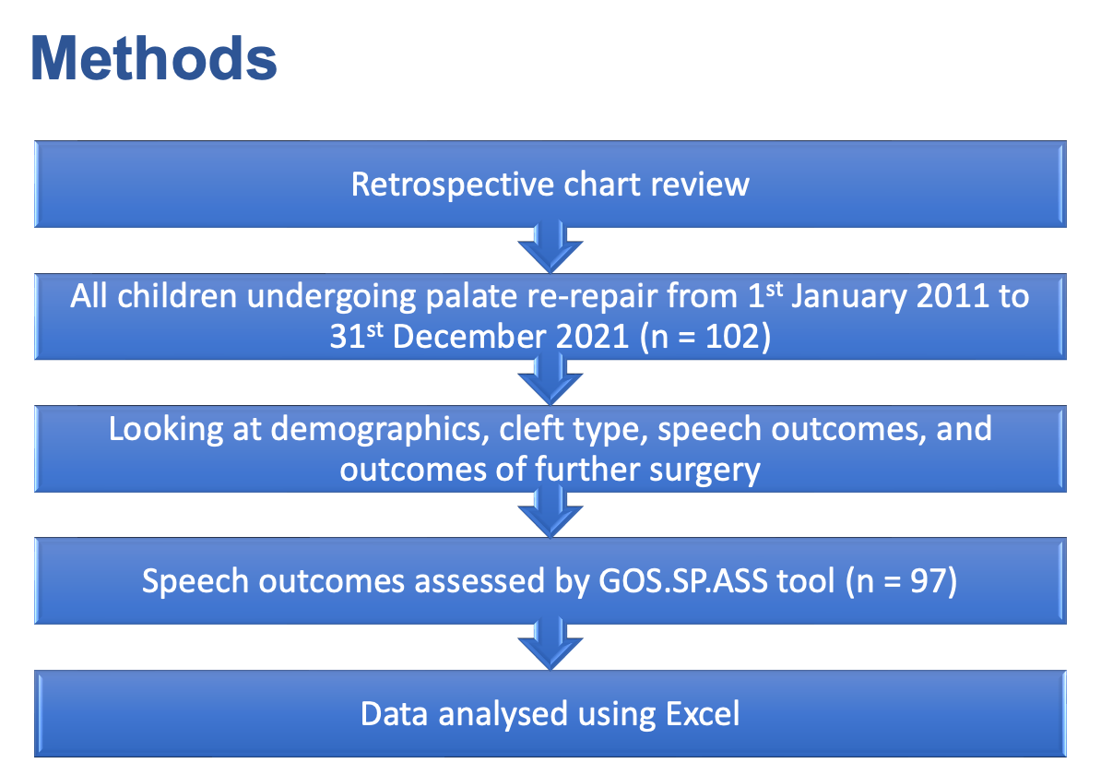
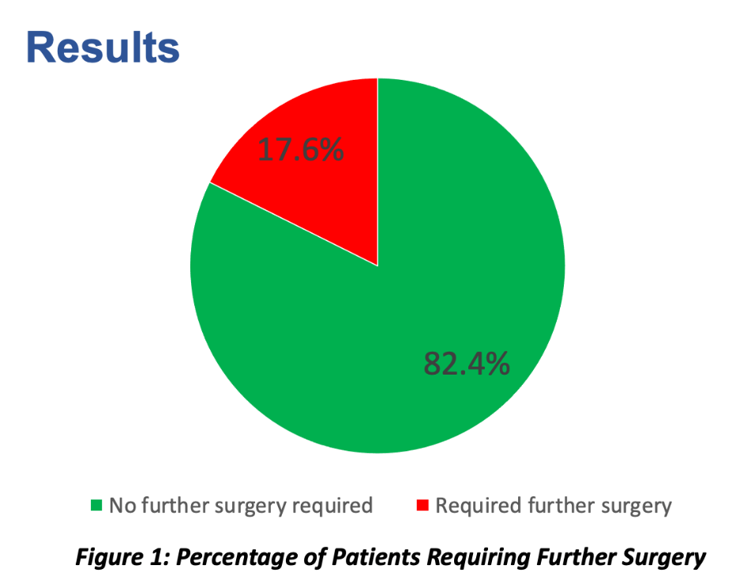
Retrospective chart review
All children undergoing palate re-repair R from 1st January 2011 to 31st December 2021 (n = 102)
Looking at demographics, cleft type, speech outcomes, and outcomes of further surgery
Speech outcomes assessed by GOS.SP.ASS tool (n = 97)
Data analysed using Excel
Retrospective chart review
All children undergoing palate re-repair R from 1st January 2011 to 31st December 2021 (n = 102)
Looking at demographics, cleft type, speech outcomes, and outcomes of further surgery
Speech outcomes assessed by GOS.SP.ASS tool (n = 97)
Data analysed using Excel

Slide 75
Manchester Approach Summary
Efficient Speech Investigation Clinic
Speech Therapist / Radiographer / Surgeon / Dentist
Waiting List / Consent / Post operative advise / Dental assessment
Palate re-repair
First line treatment including in palates where lift seems posterior
Large oral layer Z plasty / lateral scar release / midline scar excision / radical muscle dissection / buccal fat across anterior soft palate
Buccal Flap palatal lengthening
Second line if ongoing VPI after palate re-repair
Pharyngoplasty
Third line, rarely needed for cleft patients

Slide 76
Speech therapy for positive speech outcomes

Slide 77



Explanations for achieving good articulation outcomes Sharing approach to therapy
early intervention
clear criteria for intervention at AH
correspondence with local SLTs and use of digital health platforms
regular community liaison clinics
training packages and annual training day for community SLTs
time, negotiation and transparency
looking forward – Speech Path App, more detailed correspondence re outcomes

Slide 78
Q&A
Notes:
CR

Slide 79
Database developments

Slide 80
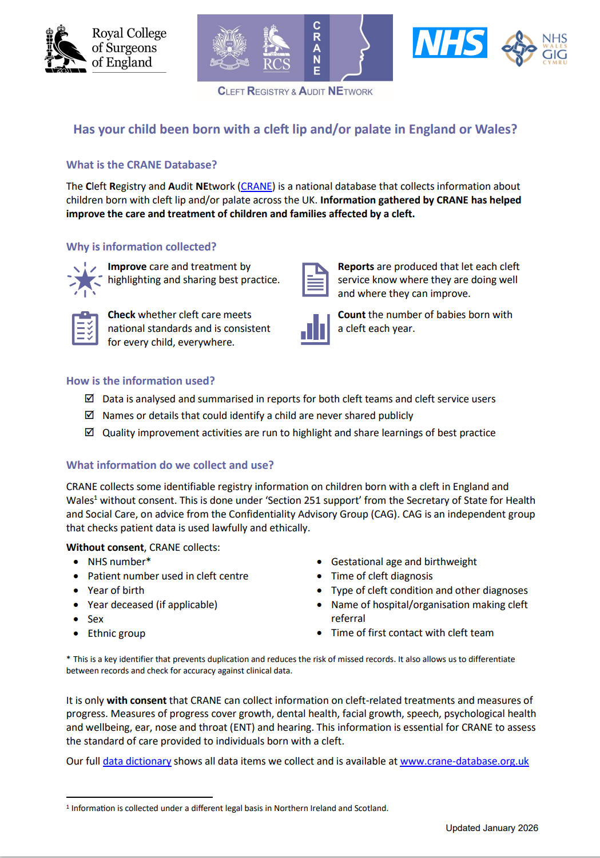
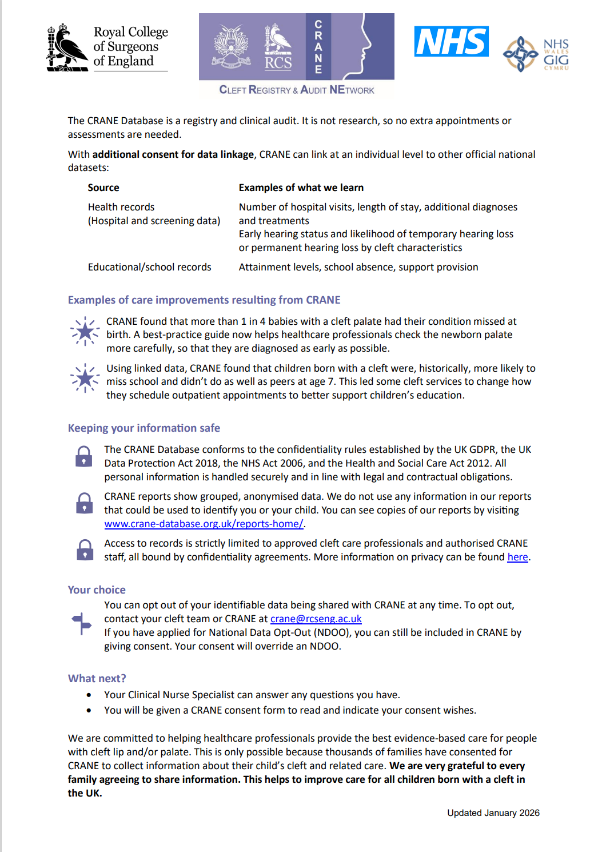

New CRANE information leaflets & consent forms
Notes:
Country-specific due to differences in legal basis for data collection without consent.
Versions for england and wales
Scotland and northern Ireland
QR code

Slide 81

Gestational age and birthweight
Now open to all registrations, not just consented cases.
CAG approval covering England and Wales. NI to follow too.
Submit data for all cases born in 2026 onwards
We are requesting an amendment to apply this change retrospectively
Adding ‘+ days’ to gestational age. Currently just whole weeks.
Moving to ‘Patient details’ tab from ‘Outcomes’ tab
We can verify our early findings that babies with cleft are more likely to be:
born premature
Born with low birthweight
Notes:
We now have CAG approval to collect gestation and birthweight for all children, not just consented cases.

Slide 82

5-year-old index
Now open to complete BCLP cases (LAHSAL)
Data can be entered retrospectively and in bulk using imports
Dr Susana Dominguez-Gonzales (Liverpool) has scores for cases going back to 2005.
CRANE will support entry of retrospective cases.

Slide 83
Cleft Q & TIM at 10y (psychology outcome)
CRANE working with Psychology CEN
There will be separate Cleft Q & TIM tabs under 10-year outcomes section on database.
Psychological and Social Functioning sub-scales to be submitted
10 questions each subscale (each rated 1’never’ to 4 ‘always’)
Cleft Q data fields should be open by May 2026
Data can be entered retrospectively and in bulk (imports)

Slide 84
Surgical timings – under consideration
Lip
Date of 1st primary lip adhesion/repair
Date definitive lip repair
Palate
Date of 1st primary palate repair
Date primary palate repair complete
Speech surgery
Date of 1st surgery for speech purposes
Date of 2nd surgery for speech purposes

Slide 85
Key dates
Q& A webinar: Monday 23 February 2026, 10:30-12:00
Dashboard Q3 25/26: Friday 13 March 2026
CD/CL webinar: Wednesday 20 May 2026, 10:30-12.00
Annual Report Extract taken: Sunday 28 June 2026
Dashboard Q4 24/25: Friday 19 June 2025
Outlier policy letters sent to Clinical Directors: August 2026

Slide 86
Thank you

